Slide 1
Expatbeleid
Internationale studenten
Migranten
Commentaar Jan Rouwendal, afd. RE, VU

Slide 2
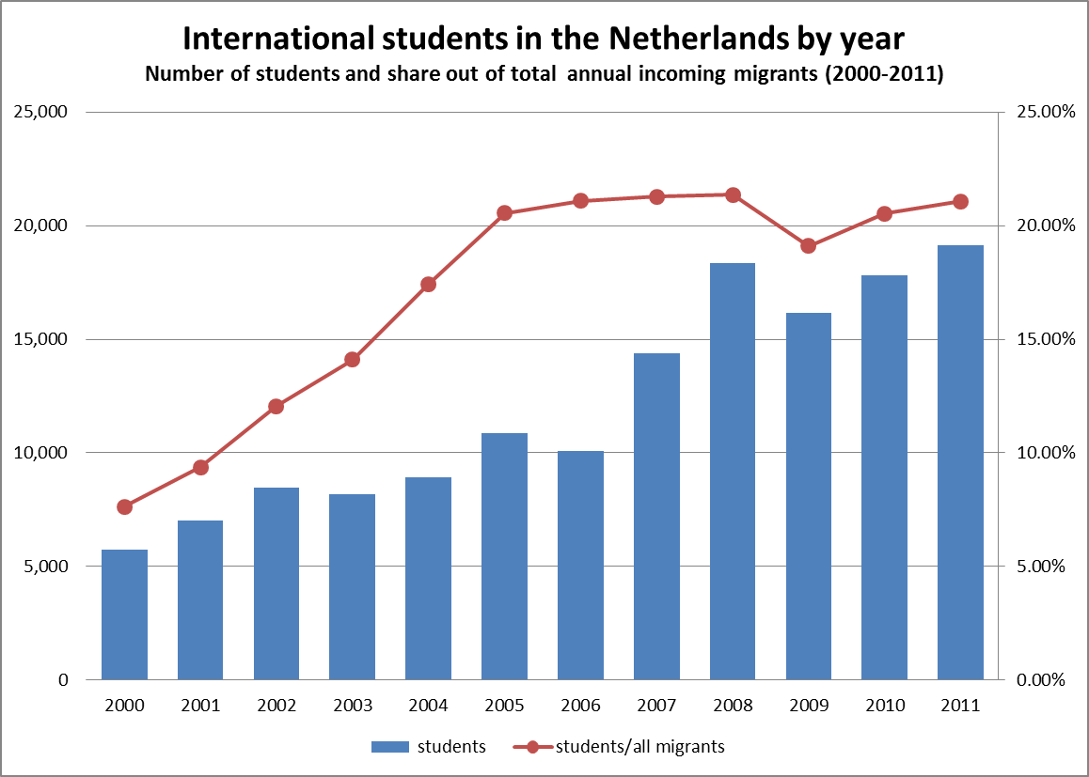
International students represent ~20% of all incoming immigrants to the Netherlands (2011).
19,100 international students arrived to the Netherlands in 2011, a growth of 230% since 1999. During this period, the number of non-student immigrants remained relatively unchanged (71,600 in 2011).
Approximately 45% of immigrants that have arrived to the Netherlands for study purposes stay in the Netherlands for at least five years.
Number of international students arriving each year, and their share out of the total number of immigrants that year [Source: CBS]

Slide 3
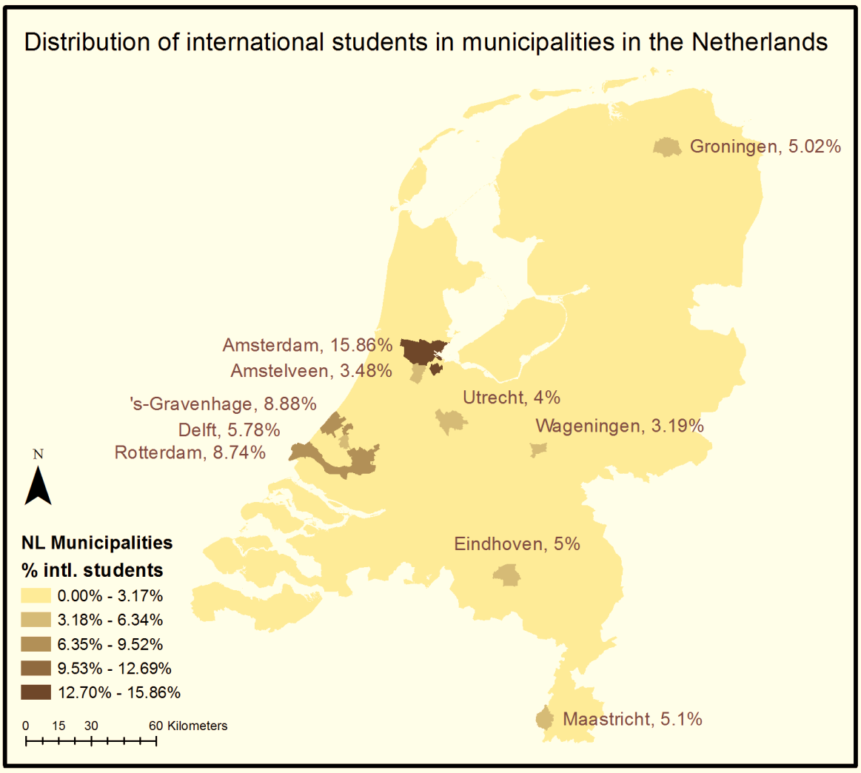
Over 50% of international students choose to live in only 6 specific municipalities.
Amsterdam is the most attractive Dutch city for international students - almost 20% of international students and graduates live in Amsterdam metropolitan area (Amsterdam and Amstelveen).
Distribution of immigrants who arrived to NL in purpose of study (both students and graduates) - registered in 1.1.2012 [Source: CBS]

Slide 4
Blijven of teruggaan?
Substantieel deel buitenlandse studenten blijft hangen
Brain drain voor land van herkomst
Voor Canada: 30% keert terug, van PhD studenten 20-25%.
Factoren: familie/partner, werk, verschil herkomst-bestemmingsland
Voor Nederland: Bijwaard en Wang
Zie figuur op volgende slide

Slide 5
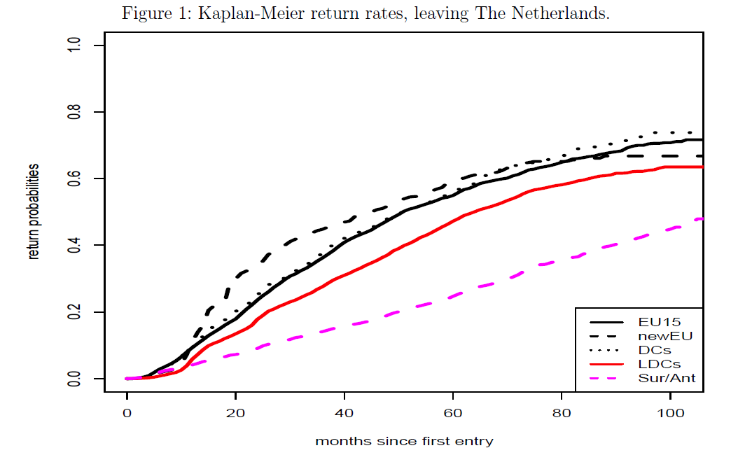

Slide 6
Marginal Willingness-to-pay for urban amenities (in Euro)‎
 | AWTP | Native-Low education | Native - High education | Migrant - Low education | Migrants - High education
Jobs | 485.1 | 442.1 | 666.9 | 434.8 | 502.0
Monuments | 15.7 | 14.4 | 16.8 | 16.0 | 25.1
Nature | 735.8 | 719.1 | 661.5 | 870.7 | 686.1
Accessibility * | -808.3 | -480.2 | -1,363.4 | -404.8 | -3,763.1
LQ (ICT industries) * | 924.5 | 252.8 | 104.1 | 2,210.8 | 6,103.7
* Based on coefficients which are not statistically significant

Slide 7
MWTP for an additional share of migrants in Randstad municipalities (by groups of skill and ‎origin).‎

