Slide 1
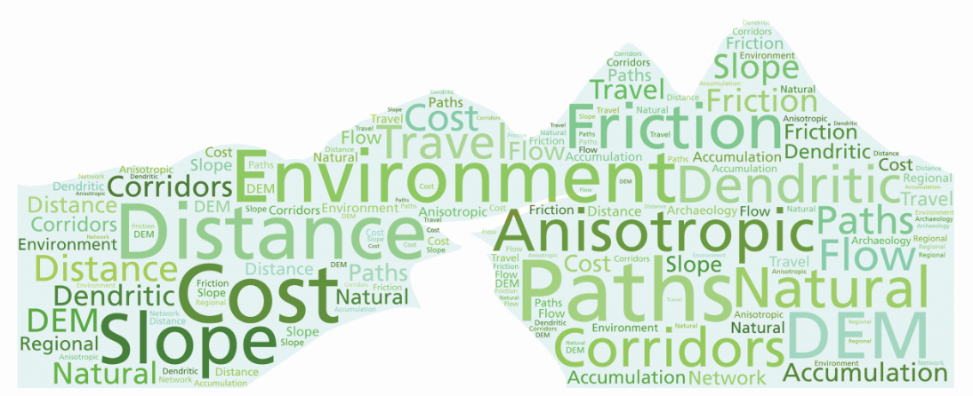
Making Tracks:
Simulating Prehistoric Human Travel Networks.
Northland, New Zealand.
MSc Dissertation
Andrew Standley
February 2015
Notes:
Hello.
My name is Andrew Standley and I’d like to present my Masters thesis presentation titled;
Making Tracks: Simulating Prehistoric Human Travel Networks, Northland, New Zealand.

Slide 2
Outline
Introduction
Research question, hypotheses and objectives
Study area
Data
Methods
Results
Conclusion
Future research
Notes:
This presentation will cover;
An introduction to the topic and the problem this research attempts to solve
This is followed by the research question, hypotheses and objectives
The study area is briefly described before moving on to;
Data sources
Methods applied
Results and interpretation
Conclusion and future research

Slide 3
Introduction
Archaeological surveys in New Zealand have mainly focused on coastal areas leaving large inland gaps in the national archaeological site database.
The archaeological literature suggests that fortified Pa sites were staged along inland travel routes as well as providing a defensive role for settlements.
Not much is known about how prehistoric people moved between sites, in particular routes taken across inland areas.
Notes:
The majority of archaeological surveys in New Zealand have been in coastal areas leaving large inland areas unsurveyed.
This is mainly due to archaeological surveys initially focusing on the rich pickings of archaeological evidence in coastal areas, and more recently responding to growth in urban development and infrastructure.
The archaeological literature suggests that fortified Pa sites were staged along key inland travel routes as well as providing a defensive role for settlements.
Not much is known about how prehistoric people may have moved between sites, in particular paths taken across inland areas.

Slide 4
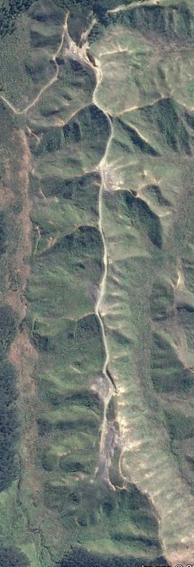
Research question
Are inland Pa sites positioned in close proximity to least cost overland travel paths?
Hypotheses
Determine if inland Pa sites (dependent variable) are unevenly distributed across the landscape. This will test the following hypothesis;
1. There is a difference between observed and expected Pa site distribution.
Test the least cost network (independent variable) model’s performance using a Gain statistic to measure Pa site distribution characteristics relative to least cost travel paths. This will test the second hypothesis;
2. Inland Pa site density measured relative to regional least cost paths will result in a Gain statistic > 0.5.
Notes:
The research question asks;
Are inland Pa sites positioned in close proximity to least cost overland travel paths?
In order to answer the question, statistical analysis will be used to test the following hypotheses;
There is a difference between observed and expected Pa site distribution
Inland Pa site density measured relative to regional least cost paths will result in a Gain statistic > 0.5

Slide 5
Objectives
Determine suitable travel cost variables.
Replicate a method of defining a regional network of least cost travel paths using a perimeter based origin-destination technique (Whitley, T.G., and Hicks, L.M., 2003. A geographic information systems approach to understanding potential prehistoric and historic travel corridors. Southeastern Archaeology 22).
Use a statistical significance test to determine whether Pa sites are normally distributed relative to primary corridors and secondary paths.
Apply a Gain statistic test to determine a relative measure of the accuracy and precision of observed Pa site distribution.
Review objectives 1-4 to answer the research questions and suggest future areas of research.
Notes:
The following objectives were set;
1. The first step was to assess which travel cost variables should be used to represent partial or complete barriers to overland ‘on foot’ travel.
2. Secondly, one of the first examples of regional least cost path modelling (Whitley and Hicks 2003) was used as the basis of a replication method, applying universal rules to a New Zealand setting.
3. When the regional travel paths were formed, the spatial relationship between Pa sites and paths was examined using the Chi Squared significance test, followed by;
4. A Gain statistic which measures the strength of association between Pa and least cost path.
Each objective was then interpreted I order to answer the research question.

Slide 6
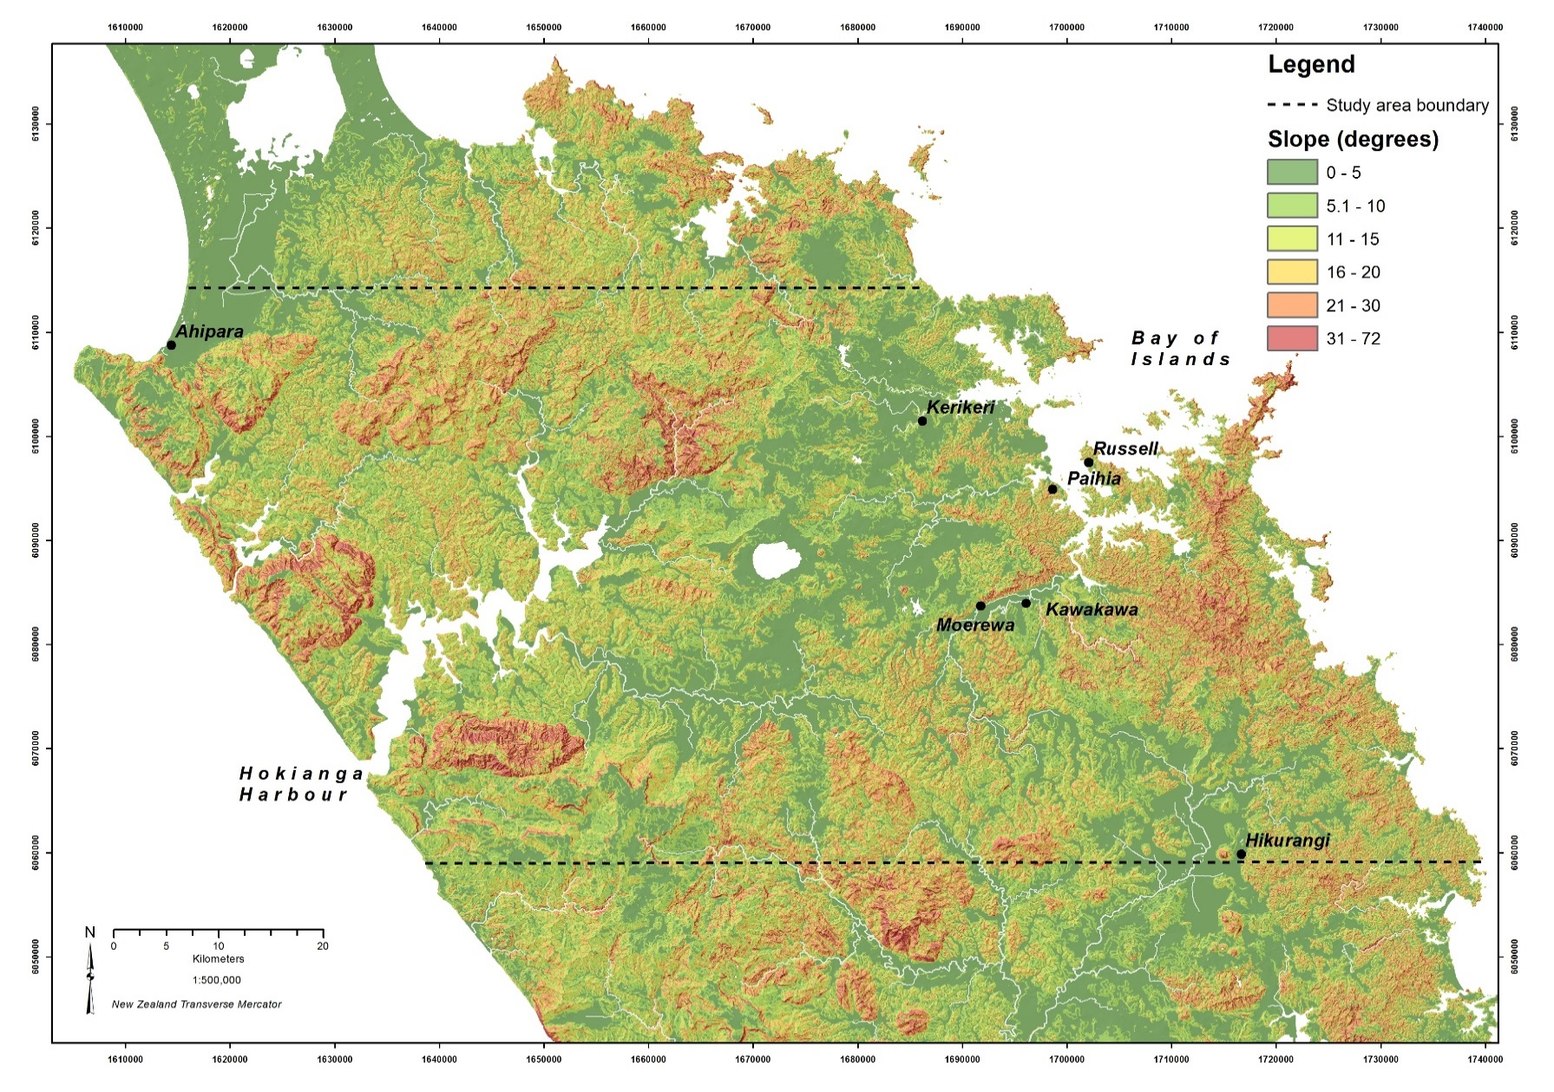
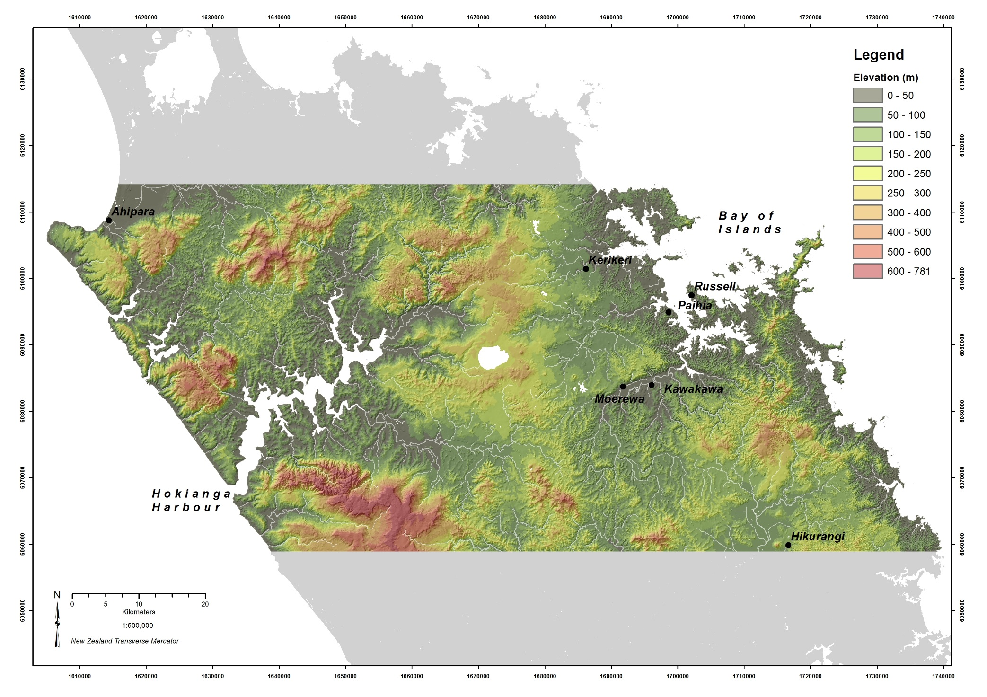
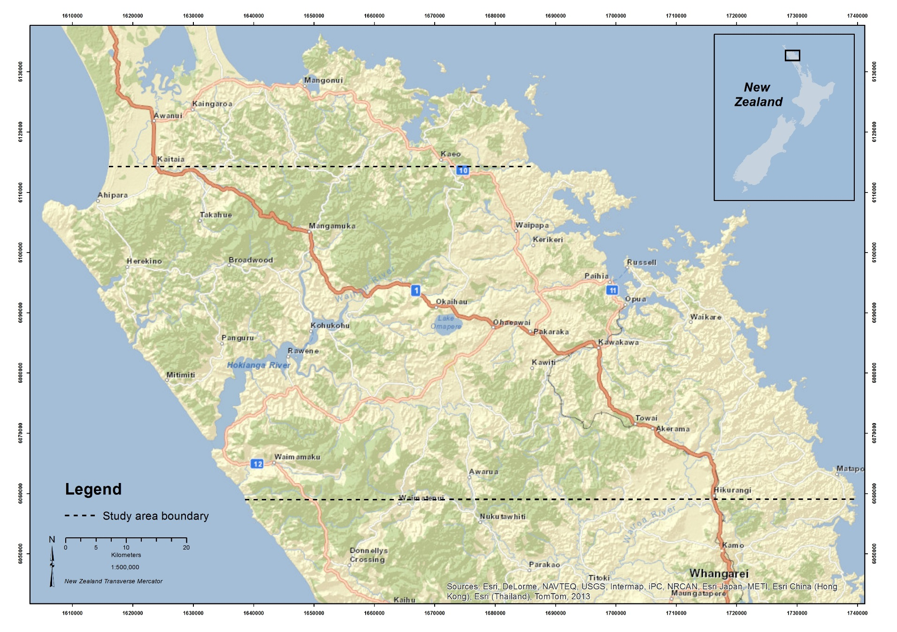
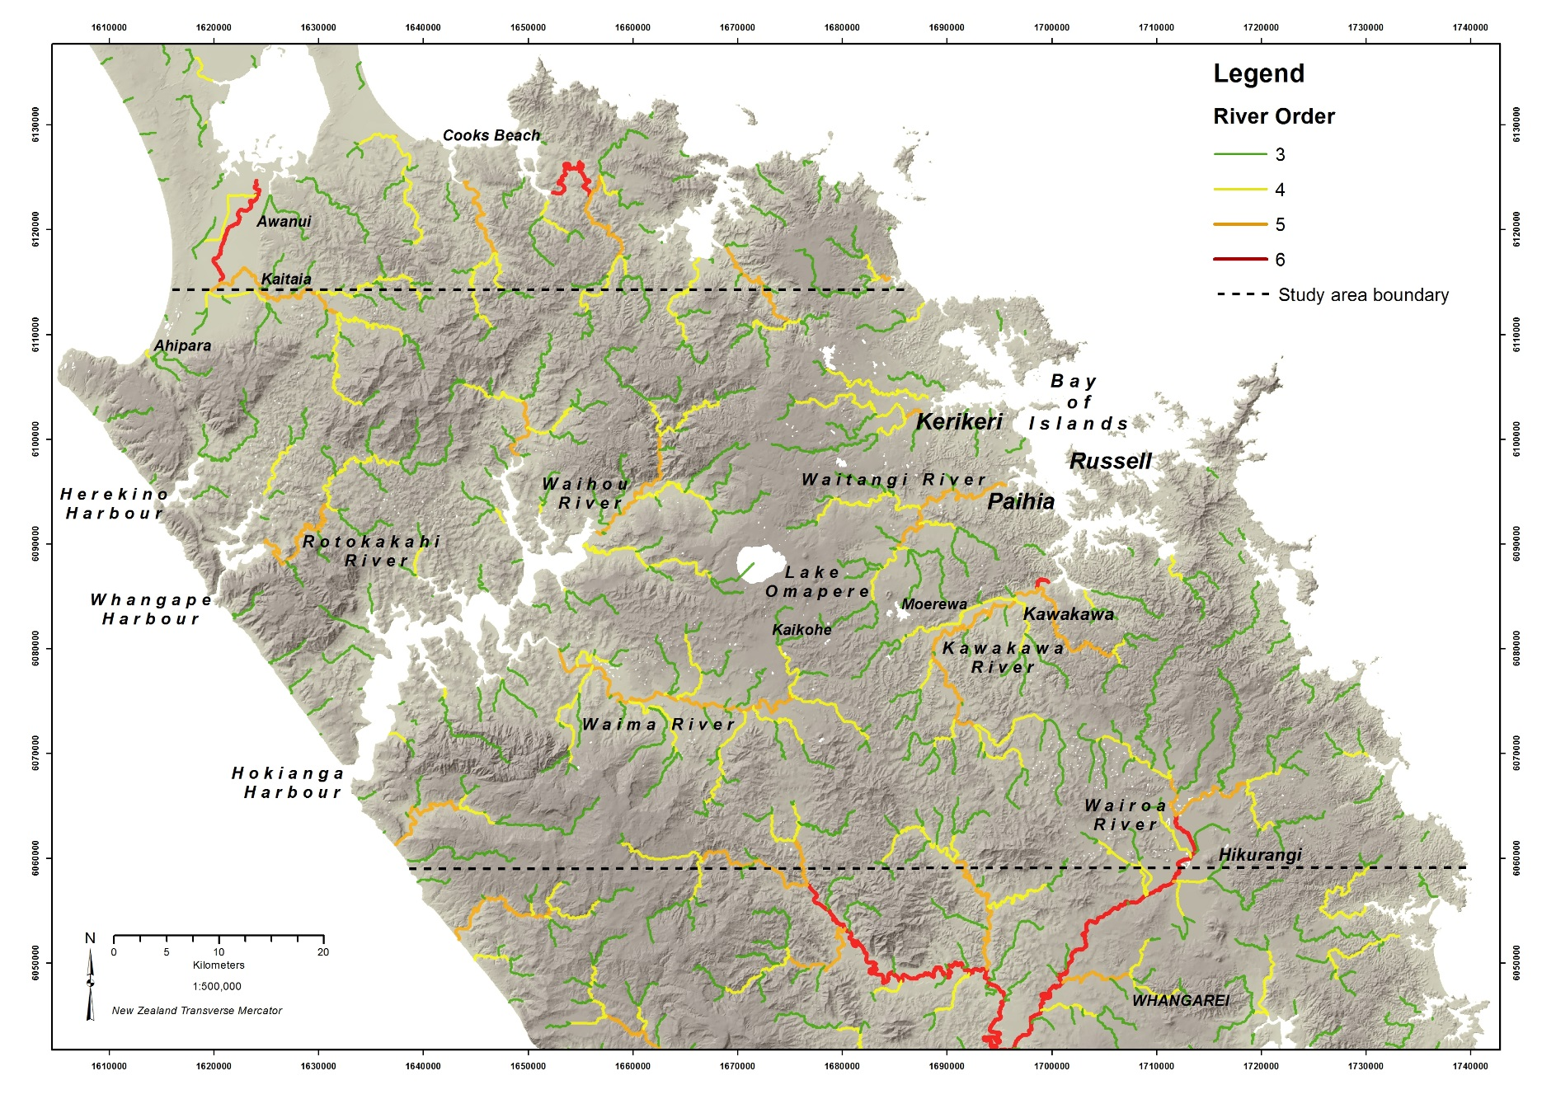
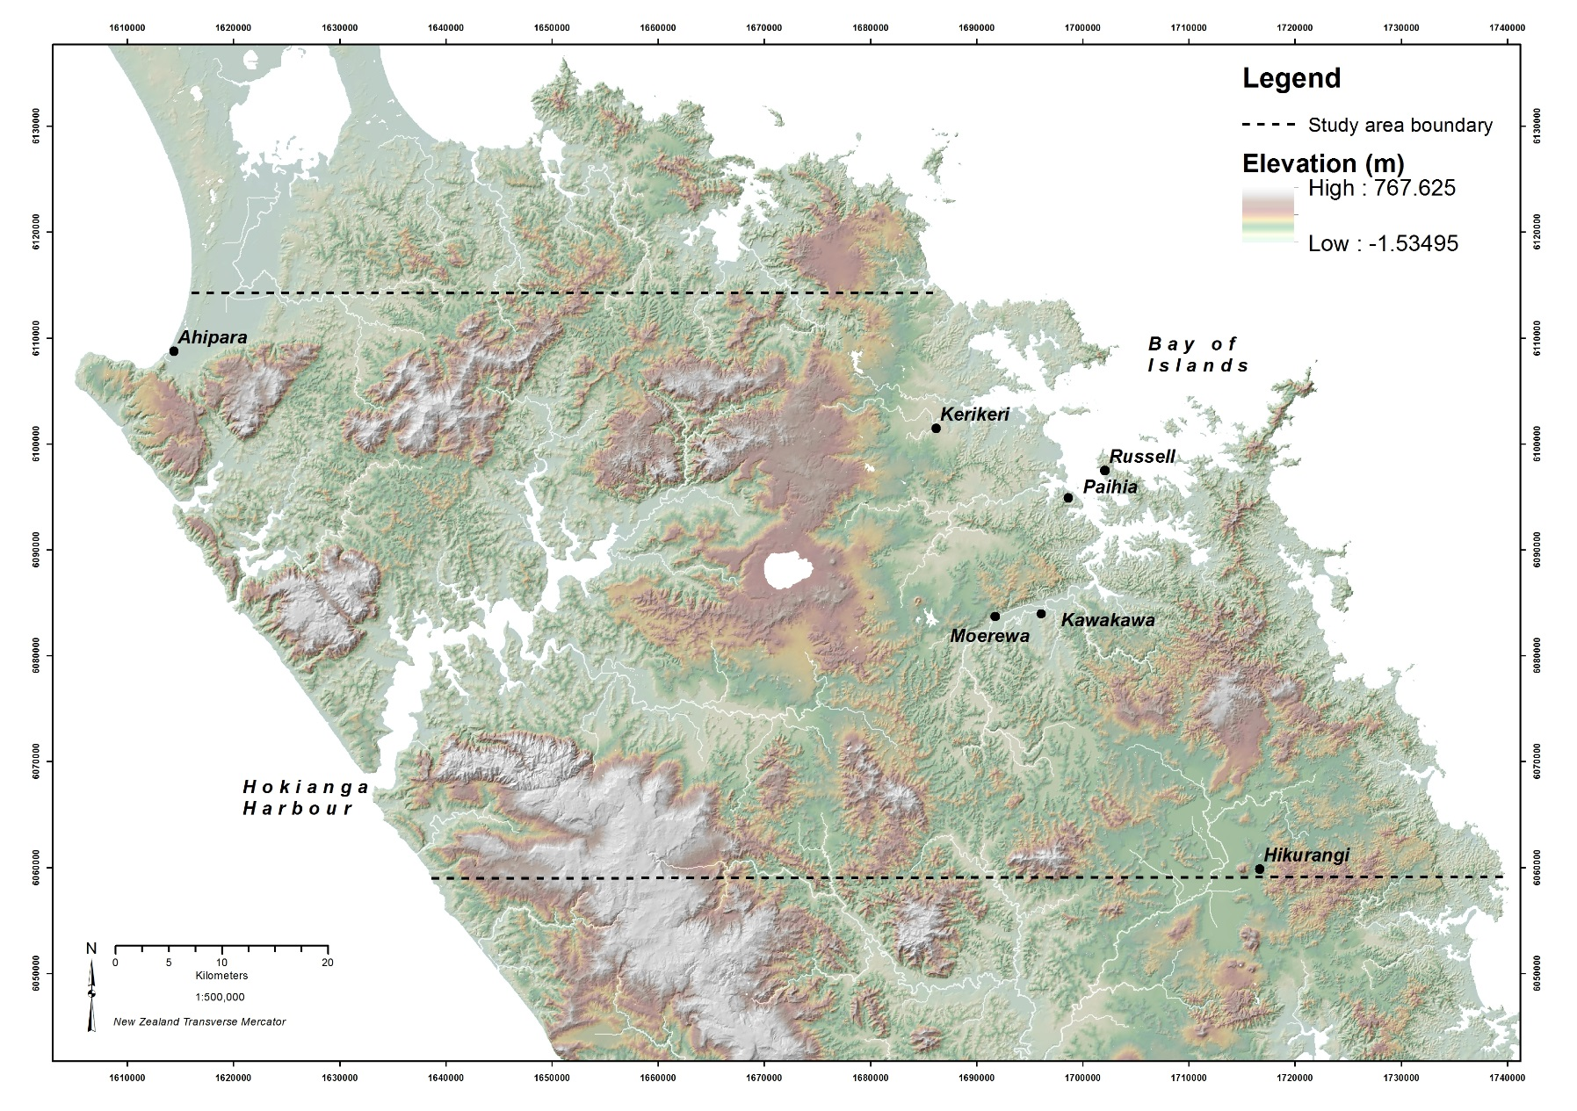
Study area
5,230 square kilometre
study area mainly in the
Far North District.
Sub tropical climate prone to erosion due to extensive land use change to dairy and sheep farming.
Hokianga Harbour
Notes:
The study area covers 5,230 square kilometres spanning the Northland peninsula from east to west coast and falling mainly within the Far North District Council area.
Topography is moderate with a relatively low 767m maximum height within the study area.
Extensive deforestation has stripped the landscape replacing natural bush with dairy and sheep farms and pine forest plantations.
The sub tropical climate supports a thriving fruit and vegetable farming community around Kerikeri in the north east.

Slide 7
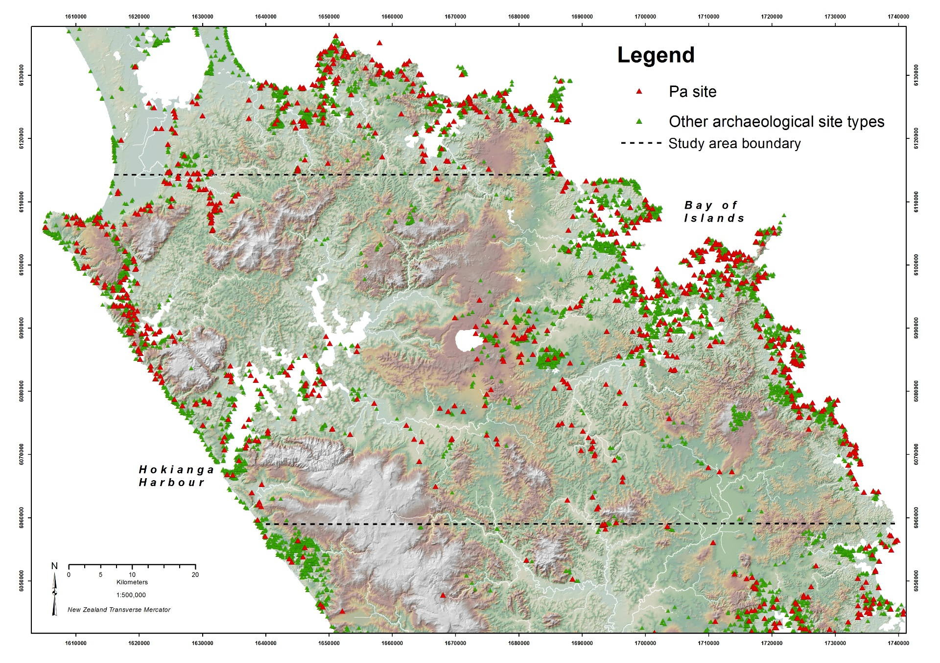
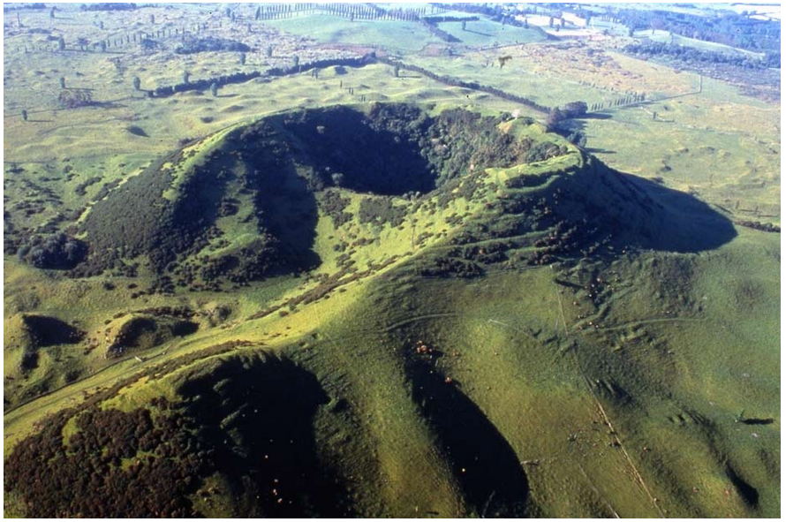
Study area
Highest pre European contact Maori population was on the east coast Bay of Islands area.
3,799 archaeological sites (NZAA)
567 Pa sites.
Inland clusters around volcanic cones with rich fertile soils.
Volcanic cone, Pouerua.
Notes:
The Bay of Islands on the east coast had the highest Maori population when Europeans arrived from 1769 AD.
The volcanic landscape is unique within New Zealand, providing rich fertile soils and culturally significant volcanic cones scattered across the eastern inland part of the study area.
The contrast in archaeological site density between the coastal and inland areas provides an ideal setting for this research.

Slide 8
Data and Software
Dataset | Format | Source
NZDEM North Island. Digital elevation model (25m resolution) | TIF | The Land Resource Information Systems Portal https://lris.scinfo.org.nz/layer/131-nzdem-north-island-25-metre/
NZ Mainland lake polygon. Digitised at 1:50,000 scale | Polygon Shape file | Land Information New Zealand https://data.linz.govt.nz/layer/293-nz-mainland-lake-polygons-topo-150k/
NIWA river order REC v2.0 | Line Shape file | The National Institute of Water and Atmospheric Research (NIWA) http://www.niwa.co.nz/freshwater-and-estuaries/management-tools/river-environment-classification-0
New Zealand Archaeological Association site data | Point Shape file | http://archsite.org.nz/
Software
ArcGIS for Desktop 10.1
ArcGIS Spatial Analyst
XLSTAT statistics software http://www.xlstat.com
Notes:
Data sources include;
Land Information New Zealand which provide a 25m resolution DEM and vector lake polygons digitised at 1:50,000 scale.
The National Institute of Water and Atmospheric Research (NIWA) was the source of the national vector river network.
The New Zealand Archaeological Association are the custodians of the national archaeological archsite database, a service managed by ESRI NZ.
All data was projected to New Zealand Transverse Mercator
Software used;
ArcGIS for Desktop version 10.1
ArcGIS Spatial Analyst
XLSTAT statistical software

Slide 9
Method - Objective 1: Cost surface composition
Lakes
Current lakes assumed to be largely unchanged
Lakes rasterised and allocated a cost value of 99, with a background value of 1.
Rivers
Travel cost method replicated (Whitley and Hicks, 2003).
Flow accumulation conditional statement used to form raster river network
Con("%flow accumulation raster%" >= 200,"%flow accumulation raster%")
Each river cell was divided by the maximum accumulated flow value to provide a continuous flow scale (0-1) from source to sea. Each cell was then multiplied by 6, representing the relative time to cross the river network at the highest flow location.
To manage the risk of least cost paths crossing single river cells diagonally avoiding the full crossing cost, the river cost raster was converted to a three cell wide river network using Euclidean Allocation.
Notes:
Objective 1 required an assessment of the variables to be used to form the travel cost surface required to control the regional least cost path network.
In the absence of historic lake records, current lakes were assumed to be suitable as complete barriers to overland human travel.
The representation of rivers followed the original author’s method of
Creating a raster river network using a standard accumulated flow technique with 200 cell threshold to eliminate insignificant streams.
Dividing all river cells by the maximum accumulated flow value (0-1 range)
Multiplying by a crossing factor (6) – relative to overland flat travel.
Today’s river network has small catchments and shallow minor rivers which don’t present a significant barrier to overland movement.
The rasterised river network was then converted to a 3 cell wide network to avoid least cost paths crossing where river cells meet diagonally, avoiding the desired river crossing travel cost.

Slide 10
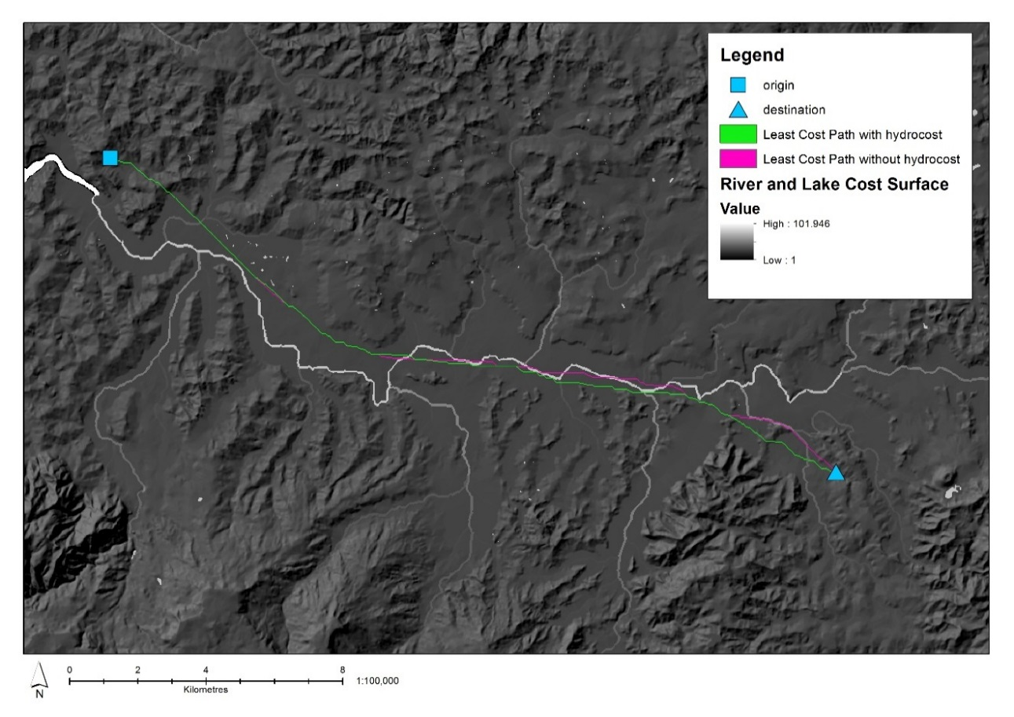
Method - Objective 1: Testing the effect of the cost surface
A test was performed to determine what effect the travel cost surface has on anisotropic least cost paths.
The costed (green path) matches the uncosted (pink path) route until they encounter the river.
The green path then cross the main river once while the pink path crosses the river several times.
Minor localised effect on least cost routes.
Notes:
The effectiveness of the river and lake travel cost surface was tested with a simple origin and destination at either end of a valley containing one of the larger river networks.
Path distance was used to generate least cost paths;
With slope cost
Without slope cost
The costed scenario crossed the main river once avoiding further crossings.
The uncosted scenario takes the optimal route down the centre of the valley as expected, crossing the river network several time.
This form of river cost can be seen to have a minor localised effect on least cost path patterns.

Slide 11
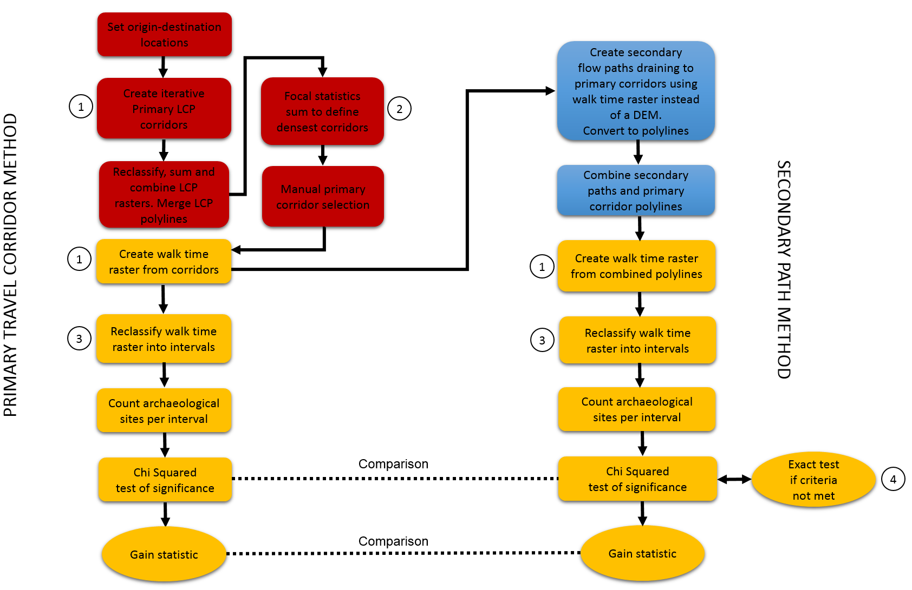
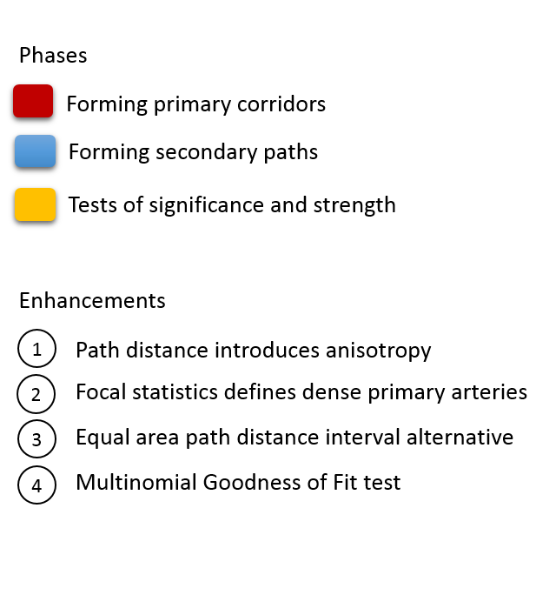
Method - Objective 2: Process overview
Notes:
This diagram provides a simplified overview of the replicated method used to model primary travel corridors and secondary paths which branch outward from the primary routes simulating foraging paths.
The process involved;
Selection of origin-destination point locations
The formation of multiple least cost path primary travel corridors
The formation of secondary paths using hydraulic flow techniques
Statistical analysis explained in the objective 3 method.
The original method was followed where possible, with adaptations indicated by;
Point 1 - Replacing the original isotropic cost distance method with anisotropic path distance
Point 2 - Use of Focal Statistics to help define the densest corridors
Point 3 - The use of Equal Area travel time interval classification as an alternative to equal cost distance intervals.
Point 4 – An exact test of significance as a workaround when replicating the original method of defining travel time intervals for counting archaeological site distribution relative to least cost paths.

Slide 12
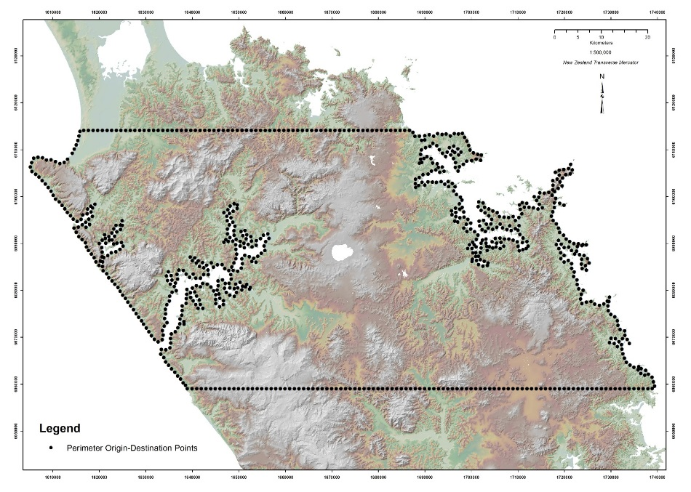
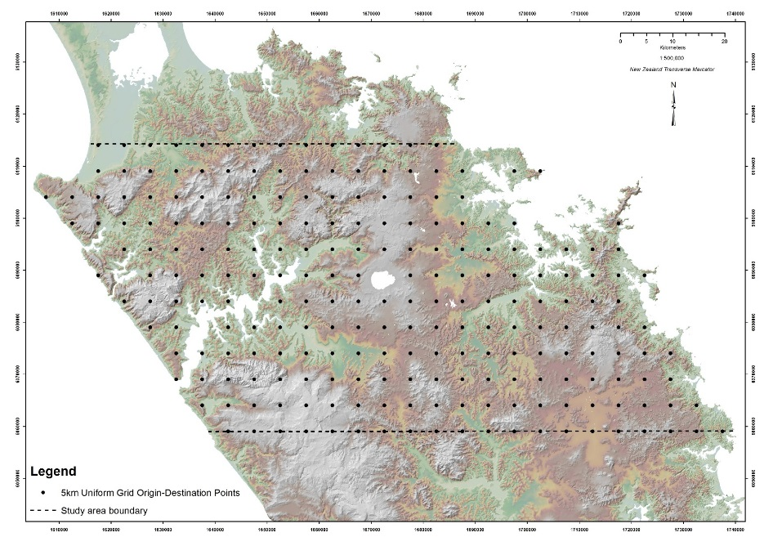
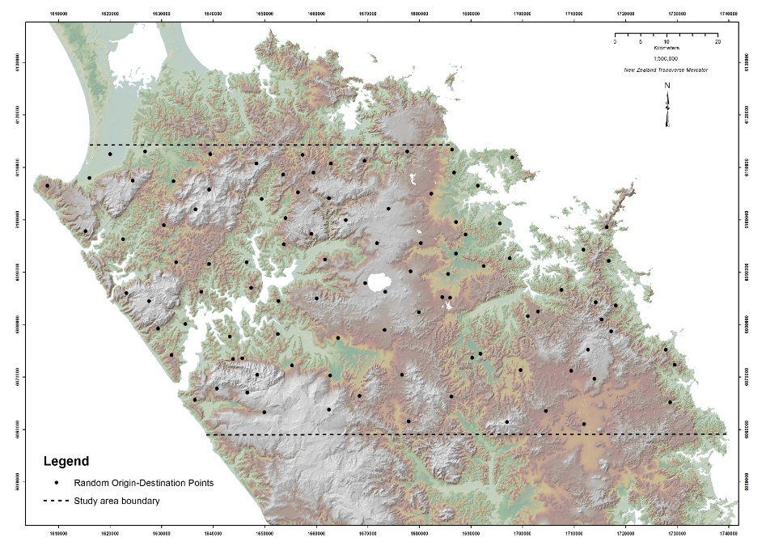
Methods for Objective 2 – Testing origin-destination patterns
A second test was performed to confirm if the pattern of regional least cost primary travel corridors persists regardless of the origin-destination pattern.
Method 1
800 perimeter origin-destinations placed
at 1Km intervals.
Method 2
225 uniform grid of origin-destinations
placed at 5Km intervals.
Method 3
100 random origin-destinations.
Notes:
The origin-destination point pattern was tested in three forms;
Method 1…the original author’s method of placing points at 1 Km intervals around the study area perimeter.
Method 2…a uniform grid of points at 5Km intervals
Method 3…100 randomly generate points.

Slide 13
Methods - Objective 2: Calculating Anisotropic Path Distance
Path Distance introduces direction of travel from a source to identify +/- slope.
Requires a DEM and a Vertical Factor table representing slope cost formed using the following equation for a range of slope values between -90 and +90 degrees.
Hours to cross 1m = 0.000166666*(exp (3.5*(ABS (Tan (Radians (slope)) + 0.05))))
(Tripcevich 2009) replicating (Tobler 1993)
Multiplied by 60 = Minutes to cross 1m (a more useful rate of movement).
Tobler’s hiking equation produces a maximum speed of 5.95 Km/hr at approx. 3 degrees downhill slope.
Used to form path distance raster inputs for Cost Path tool and for travel time interval areas.
Tobler, W. 1993. Three Presentations on Geographical Analysis and Modeling. Technical Report 93-1. National Center for Geographic Information and Analysis. (Online) http://www.ncgia.ucsb.edu/Publications/Tech_Reports/93/93-1.PDF.
Ref: Tripcevich, N. 2009. Workshop 2009, No1. Viewshed and Cost Distance. (Online) http://mapaspects.org/book/export/html/3743
Notes:
Path distance settings followed a published example by Tripcevich where the slope cost is represented as a Vertical Cost table calculated using this formula in Microsoft Excel for a range of slope values between -90 & 90 degrees. The slope intervals do not have to be equal as ArcGIS interpolates between values.
The result produces a rate of movement (speed) measured in hours to cross 1m.
This is multiplied by 60 to produce a more useful minutes to cross 1m.
The Path Distance tool automatically factors in the raster cell size so only requires a rate of movement as input.

Slide 14
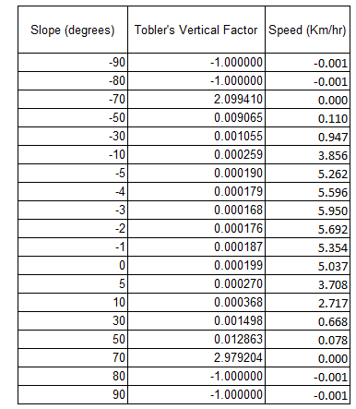
Methods - Objective 2: Primary corridor workflow
Geo-processing steps used an iterative function to loop through sequentially referenced origin points.
800 Path Distance raster datasets were generated (one from each origin)
799 Least Cost Paths generated from each origin (total of 639,200 individual paths)
Surface raster
Raster LCP
Vector LCP
Vertical raster
Notes:
ArcGIS Model Builder was used to link several geo-processing tools together to form the primary corridors.
800 Path Distance raster datasets were generated
639,200 individual Least Cost Paths were created (800 sets of 799 paths)

Slide 15
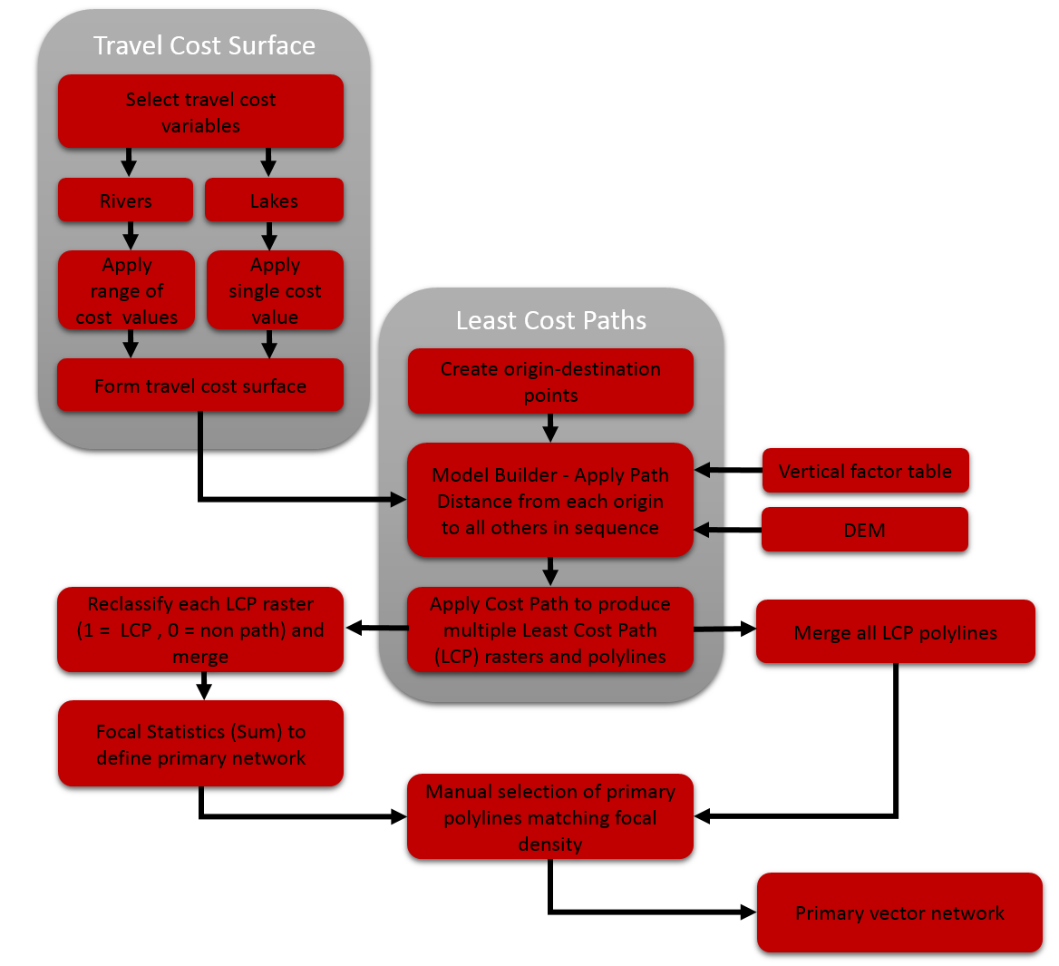
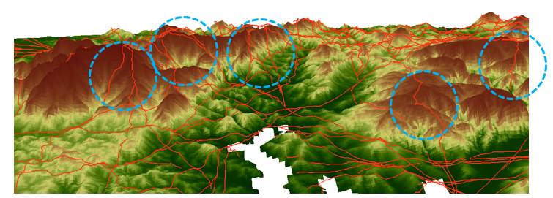
Methods - Objective 2 – Primary corridor workflow
Least cost paths were produced from each origin to all destinations.
All raster LCP datasets were reclassified to (1,0) and combined using cell statistics (Sum).
Focal statistics was used to refine the merged dataset picking up adjacent path density to form major corridors.
Vector polylines were manually selected using the focal density as a guide.
Notes:
The overall process for creating the primary corridor network is shown here.
Least Cost Path raster datasets were combined using Cell Statistics.
Focal Statistics was used to create a path density dataset to help visualise the denser parts of the dataset. This used a 100m radius search around each cell to pick up adjacent and coincident paths which identified broad corridors.
The aim was to select the main corridors from the vector network required for further analysis. The original method of manual selection could not be improved, but the path density dataset created by Focal Statistics indicated which paths to select.

Slide 16
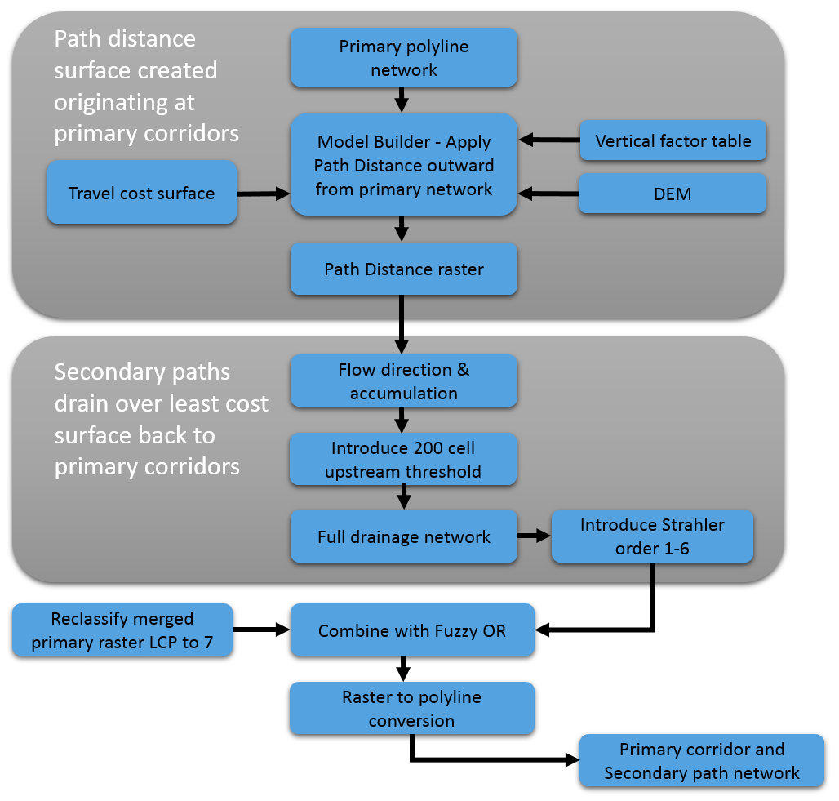
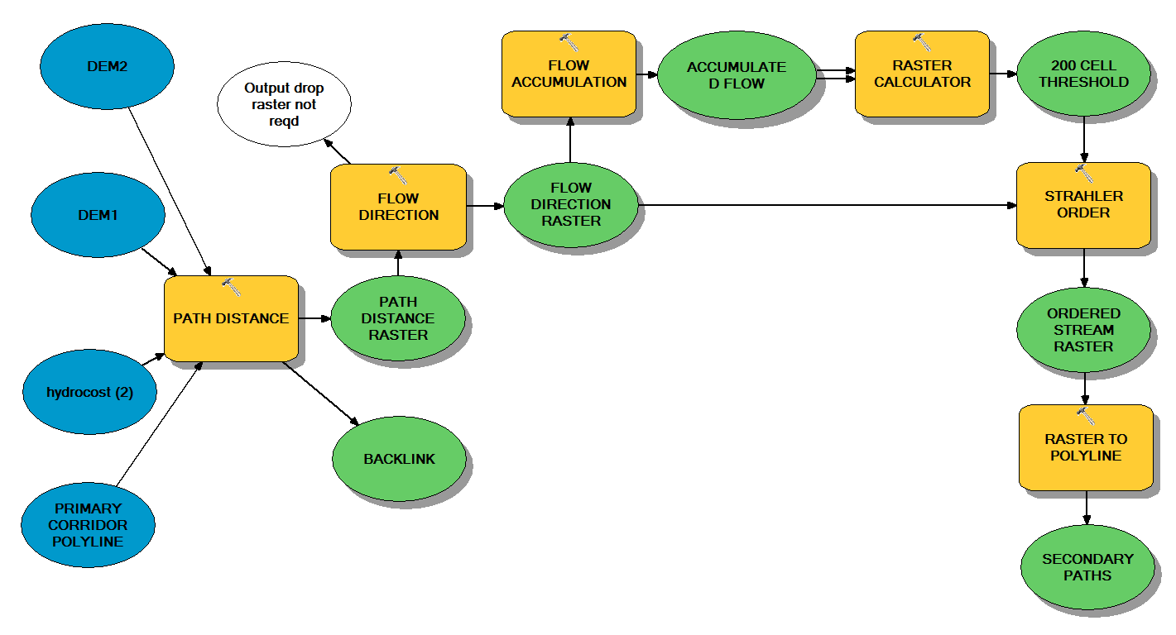
Methods for Objective 2 – Secondary path workflow
Primary vector corridor network used as the origin.
Anisotropic path distance generated moving away from the primary corridors.
Flow accumulation method used replacing the DEM surface with the path distance surface above.
Notes:
The replicated method used river modelling techniques to create secondary paths.
Instead of a DEM surface used to create a river network, a Path Distance raster was used originating at the vector primary corridor network.
The path distance raster sinks were filled, and flow direction and accumulation generated with a 200 upper drainage cell threshold applied to simplify the paths.
The secondary paths needed to be combined with the primary corridors. To do this river order values were created during the modelling process.
Primary paths were reclassified to order 7 and combined with the secondary path order values using Fuzzy OR which retains the maximum coincident value.
This was purely as a visual QA to check the river order values had combined correctly.

Slide 17
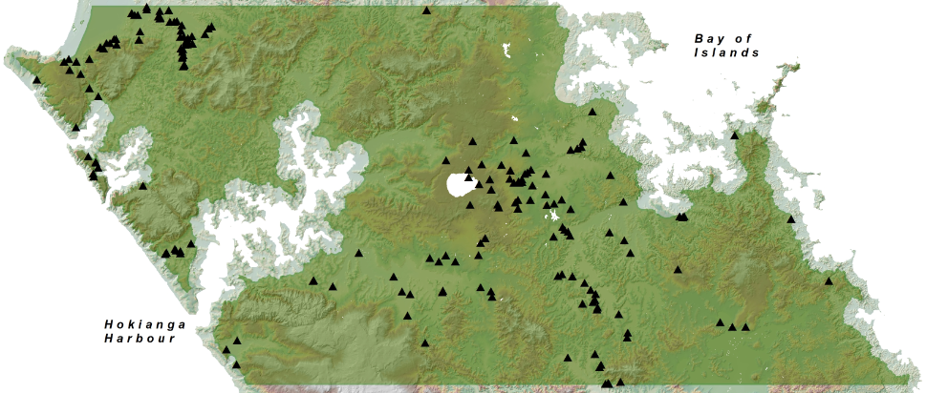
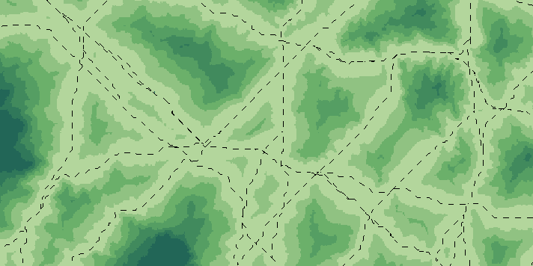
Methods for Objective 3 –Test of Significance
Defining inland Pa sites
Assumption - coastal Pa site position driven by access
to coastal resources not proximity to regional trails.
Inland environment created by calculating a 30 minute
walk time raster from the coastline.
181 inland Pa.
Measuring Pa proximity to paths
Walk time raster originating from each path network.
Reclassified;
7 x 4 minute travel time intervals
7 x equal area intervals
Notes:
Preparation for statistical analysis included;
Defining inland Pa sites
As coastal Pa sites were probably positioned for good access to coastal resources rather than proximity to inland travel routes, it was necessary to classify inland Pa sites.
An inland environment was created by calculating a 30 walk time boundary from the coast line. This resulted in 181 Pa sites falling within the inland environment.
Measuring Pa proximity to paths
Walking time rasters were generated originating at each vector network.
In each case, the path distance raster was reclassified into;
4 minute travel time intervals (the original author’s equal cost distance method)
Equal area intervals using ArcGIS Quantile classification..equal cell count per interval = equal area
The number of observed Pa sites falling within each path distance interval were counted.

Slide 18
Methods for Objectives 3 and 4 - Test of Significance & Strength
Pearson’s Chi Squared test of significance was calculated for the Pa site counts per interval
using Microsoft Excel at the 99% (0.01) significance level;
X² = ∑ (O – E)²
E
Where
O = the number of observed sites per interval.
E = proportion of expected sites per interval (relative to interval % area)
Kvamme’s Gain statistic is used to measure model performance.
In this case observed and expected site counts from the Chi Squared test of significance were used as variables to calculate the Gain statistic which will always fall between 0 and 1.
1 – (Pa / Ps)
Where
Pa = % path distance interval area vs study area
Ps = % of observed sites per interval
Notes:
The statistical significance test was performed using Pearson’s Chi Squared test. The aim of the test of significance is to test the 1st hypothesis - whether Pa sites are evenly distributed or not.
Observed site counts per interval were compared with an Expected site count.
Expected site counts are based on the proportion of the interval area vs the whole study area.
Expected site counts per interval must be > 1.5, but ideally >5 (Cochran 1952).
Failure to comply will require an Exact test…in this case, a Multinomial Goodness of Fit test which uses Monte Carlo simulation to generate sufficiently large enough expected counts for a valid test.
The Gain test (Kvamme 1988) measures the strength of the relation between site and path.
% of each interval area as a proportion of the study area (referred to as accuracy)
% of observed sites per interval (referred to as precision)

Slide 19
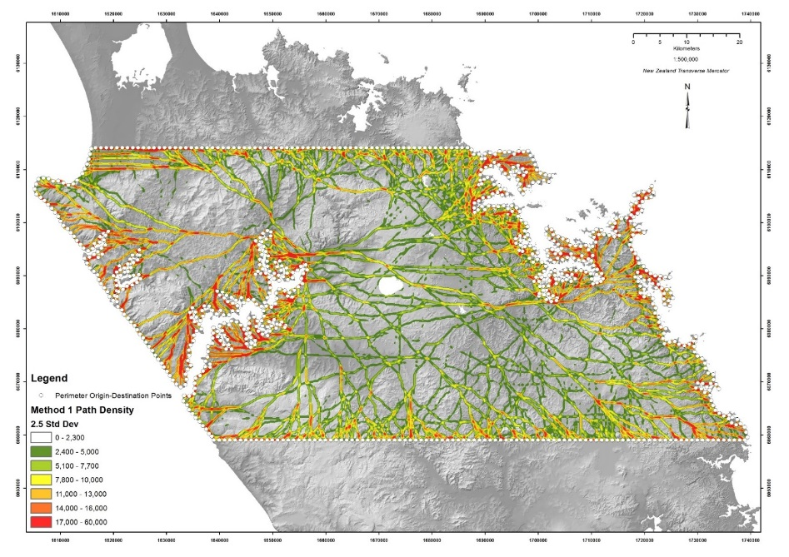
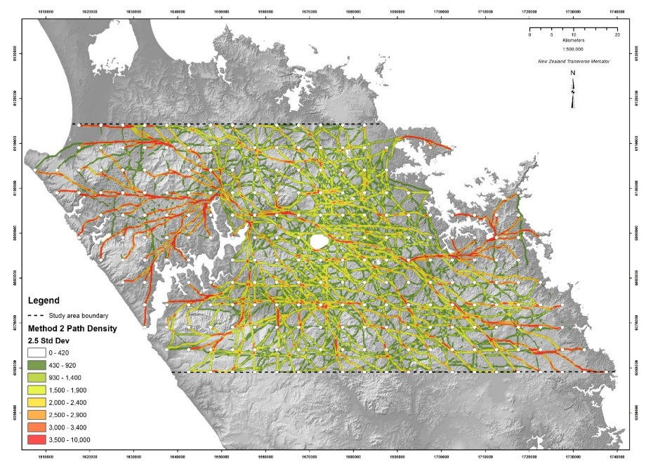
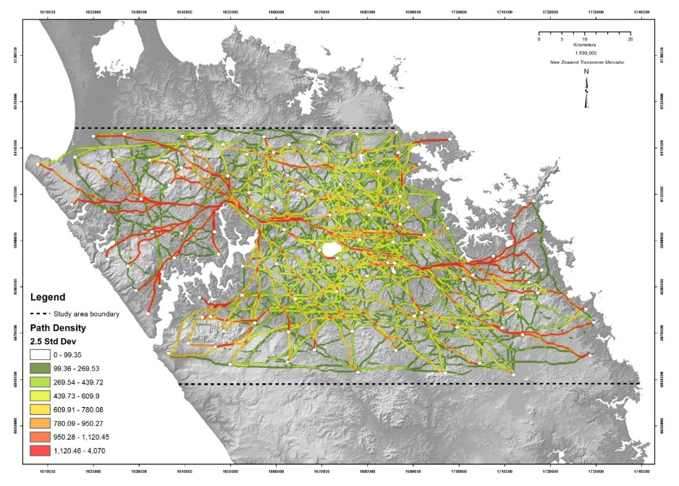
Results for Objective 2 – Primary corridor origin-destination pattern effects
Primary travel corridor Method
Identical classifications (Standard Deviation) were used to compare the results from each method.
With some local exceptions, the densest corridors are replicated each time.
Method 1 (perimeter points) was used for the remaining analysis.
Method 1
Method 2
Method 3
Notes:
The Primary corridor method applied to three Origin-Destination patterns confirmed that the main low cost corridors generally persist when origin positions change.
This will be the case as long as there is a reasonably even distribution of points.
Method 1…the 800 perimeter origins was selected for the remainder of the study.

Slide 20
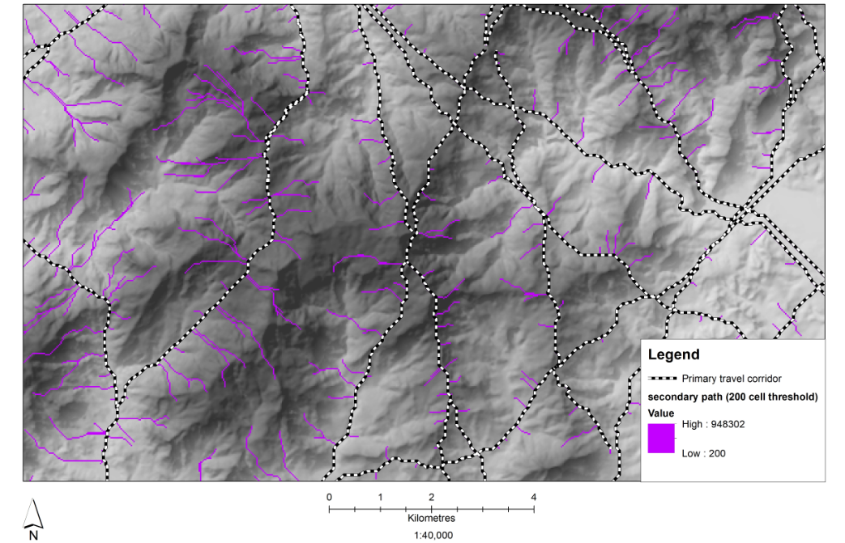
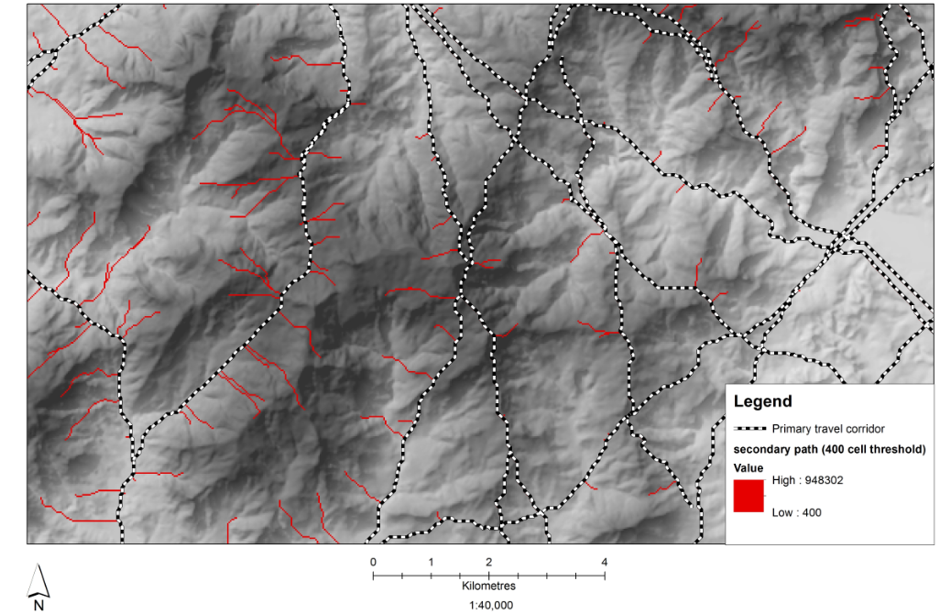
Results for objective 2 – Secondary paths threshold tests
Testing of different flow accumulation thresholds was required to determine a suitable value.
Values of 100, 200, 300 and 400 were tested. 200 upstream cells was selected.
200 cell threshold network
400 cell threshold network
Notes:
The secondary flow path results are shown here with the chosen 200 upper flow threshold limit applied and an alternative 400 cell threshold.

Slide 21
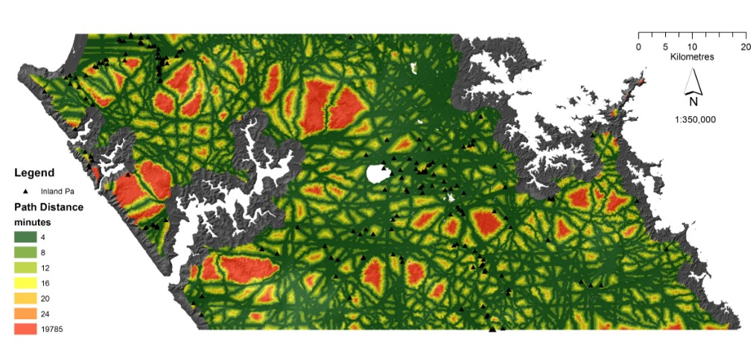
Results for Objective 3 – Statistical significance (Equal cost distance intervals)
Path distance originating from primary paths by 7 equal travel time intervals.
Notes:
The original author’s use of equal cost distance intervals for measuring site density was recreated here originating at the Primary Corridor network at 4 minute walk time intervals.
This example shows the limitations of least cost path methods on flat terrain where primary paths are closely positioned.
The interval areas produced here were sufficient to generate valid expected site counts for the Chi Squared test.

Slide 22
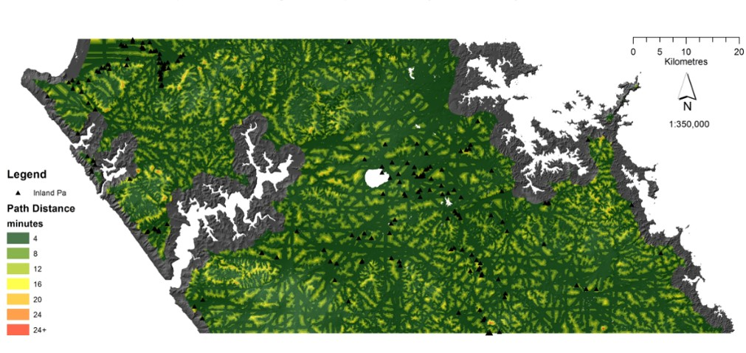
Results for Objective 3 – Statistical significance (Equal cost distance intervals)
Path distance originating from combined Primary and Secondary paths by 7 equal travel time intervals.
Notes:
Equal cost distance intervals from the combine primary & secondary paths produce what appears to be a highly accessible study area, with almost all areas within a 16 minute walk from a path.
The original author’s method fails here - the more complex combined network produced some walking time interval areas that were too small to produce valid expected site counts for the Chi Squared test.

Slide 23
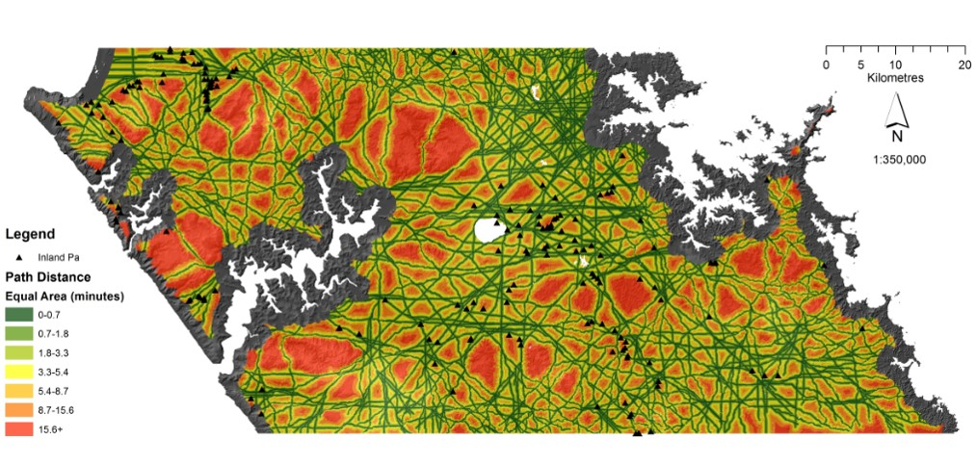
Results for Objective 3 – Statistical significance (Equal area intervals)
Path distance originating from primary paths by equal area intervals
Notes:
The alternative Equal Area path distance classification from Primary Corridors produces narrower intervals around each corridor resulting in a clearer definition of each corridor.
Note many more of the outer red interval areas shown due to the equal area method compared to equal time.
The ArcGIS quantile classification method produced a slightly uneven area split with two of the seven intervals having between 1% and 3% less area than others, however this is not considered significant.

Slide 24
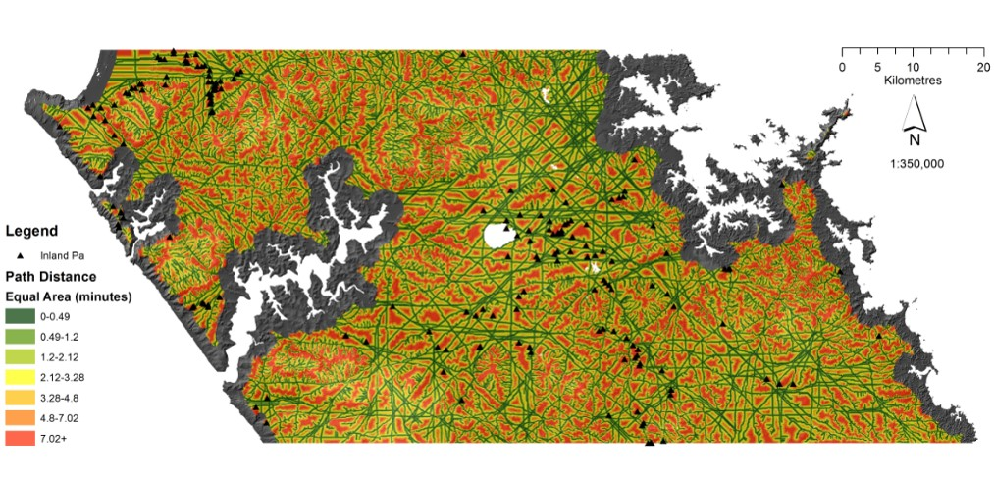
Results for Objective 3 – Statistical significance (Equal area intervals)
Path distance originating from combined paths by equal area intervals
Notes:
Equal Area intervals from the combined path network produced a path network that penetrates all areas leaving only small pockets shown in red.

Slide 25
Results for objective 2 – Chi Squared test results
(equal travel cost intervals from primary paths)
Travel time (mins) | 0 -4 | 4-8 | 8-12 | 12-16 | 16-20 | 20-24 | 24+ | Total
Observed sites | 74 | 56 | 36 | 6 | 2 | 3 | 4 | 181
Expected sites | 89.79 | 38.37 | 20.40 | 11.13 | 6.14 | 3.65 | 11.52 | 181
Area (Km2) | 2103.63 | 898.92 | 477.99 | 260.71 | 143.73 | 85.49 | 269.89 | 4240.37
χ2 = Σ(O-E)^2/E | 2.78 | 8.10 | 11.92 | 2.36 | 2.79 | 0.12 | 4.91 | 32.98
% Area | 0.50 | 0.21 | 0.11 | 0.06 | 0.03 | 0.02 | 0.06 | 1.00
% Observed sites | 0.41 | 0.31 | 0.20 | 0.03 | 0.01 | 0.02 | 0.02 | 1.00
α | 0.01
df | 6.00
χ2 | 32.98
χ2-crit =CHINV(α,DF) | 16.81
p-value | 0.000011
sig | yes
Gain Statistic | -0.21 | 0.31 | 0.43 | -0.85 | -2.07 | -0.22 | -1.88
Path distance originating from combined paths by equal area intervals
Notes:
The Chi Squared test result for Equal travel time from primary corridors produced a p value of 0.000011, and a Chi Squared statistic of 32.95 significantly higher than the target critical value of 16.81, strongly rejecting the null hypothesis, confirming uneven site distribution.
This valid test suggests that Pa sites are clustered within the 4 – 12 minute walking range from primary paths.
The Gain statistic of 0.43 is below moderate strength.

Slide 26
Results for objective 2 – Chi Squared test results
(equal travel cost intervals from primary and secondary paths)
Travel time (mins) | 0 - 4 | 4-8 | 8-12 | 12-16 | 16-20 | 20-24 | 24+ | Total
Observed sites | 91 | 61 | 22 | 5 | 1 | 0 | 1 | 181
Expected sites | 116.21 | 46.36 | 15.07 | 2.27 | 0.31 | 0.04 | 0.74 | 181
Area (Km2) | 2722.42 | 1086.13 | 353.16 | 53.10 | 7.22 | 1.02 | 17.32 | 4240.37
χ2 = Σ(O-E)^2/E | 5.47 | 4.62 | 3.18 | 3.30 | 1.55 | 0.04 | 0.09 | 18.25
% Area | 0.6420 | 0.2561 | 0.0833 | 0.0125 | 0.0017 | 0.0002 | 0.0041 | 1
% Observed sites | 0.50 | 0.34 | 0.12 | 0.03 | 0.01 | 0 | 0.01 | 1
α | 0.01
df | 6
χ2 | 18.25
χ2-crit =CHINV(α,DF) | 16.81
p-value | 0.005627
sig | yes
Gain Statistic | -0.28 | 0.24 | 0.31 | 0.55 | 0.69 | ­ | 0.26
Chi Squared for Pa proximity to the combined path network appears to strongly reject the null hypothesis.
Moderate – strong Gain results for the 12-16 and 16-20 minute walk range are false as the test is invalid.
Expected site counts and interval areas do not meet the minimum requirements for Chi Squared
Exact test required in order to complete the test.
Notes:
Chi Squared results for Pa proximity to primary and secondary paths produced a Chi Squared statistic on 18.25 compared to the target critical value of 16.81. indicating weaker level of significance than Pa proximity to primary corridors alone.
The p value of 0.005 still strongly rejects the null hypothesis.
Although the Gain statistic for the 12-16 minute interval (0.55) and the 16-20 minute interval (0.69) show a moderate and strong relationship between site and path respectively, they are based on intervals with very low site counts and areas.
4 out of the 7 intervals have expected site counts less than 5.
3 of the 7 less than 1.
This distribution failed to meet the minimum requirements for Chi Squared. Although the problems stems from equal area intervals not being used, the original author’s method was completed using the exact test for Chi Squared with more than two categories…the Multinomial Goodness of Fit test.

Slide 27
Results for objective 2 – Multinomial Goodness of Fit test results
(equal travel cost intervals from primary and secondary paths)
Multinomial Goodness of Fit: with Monte Carlo simulation (Number of simulations = 10,000) – 1% confidence level
Travel Time Interval (Mins) | Chi-square (Observed value) | Primary Chi-square (Critical value) | Degrees of Freedom | P value | Alpha value | Null hypothesis | Risk to reject null
4 | 18.254 | 28.587 | 6 | 0.054 | 0.01 | Accepted | 5.42%
Applied as a workaround for the original cost distance interval method of counting site density.
Failed to reject the null hypothesis
Relatively even distribution.
Expected if secondary paths penetrate areas suitable for Pa sites.
However;
This statistical method is not required if equal area intervals are used.
Multinomial Goodness of Fit: with Monte Carlo simulation (Number of simulations = 10,000) – 2% confidence level
Travel Time Interval (Mins) | Chi-square (Observed value) | Primary Chi-square (Critical value) | Degrees of Freedom | P value | Alpha value | Null hypothesis | Risk to reject null
4 | 18.254 | 26.164 | 6 | 0.051 | 0.02 | Accepted | 5.14%
Multinomial Goodness of Fit: with Monte Carlo simulation (Number of simulations = 10,000) - 3% confidence level
Travel Time Interval (Mins) | Chi-square (Observed value) | Primary Chi-square (Critical value) | Degrees of Freedom | P value | Alpha value | Null hypothesis | Risk to reject null
4 | 18.254 | 24.150 | 6 | 0.048 | 0.03 | Accepted | 4.83%
Multinomial Goodness of Fit: with Monte Carlo simulation (Number of simulations = 10,000) - 4% confidence level
Travel Time Interval (Mins) | Chi-square (Observed value) | Primary Chi-square (Critical value) | Degrees of Freedom | P value | Alpha value | Null hypothesis | Risk to reject null
4 | 18.254 | 23.089 | 6 | 0.053 | 0.04 | Accepted | 5.29%
Multinomial Goodness of Fit: with Monte Carlo simulation (Number of simulations = 10,000) - 5% confidence level
Travel Time Interval (Mins) | Chi-square (Observed value) | Primary Chi-square (Critical value) | Degrees of Freedom | P value | Alpha value | Null hypothesis | Risk to reject null
4 | 18.254 | 21.167 | 6 | 0.054 | 0.05 | Accepted | 5.37%
Notes:
The Multinomial Goodness of Fit test used Monte Carlo simulation involving 10,000 simulations required to generate scenarios containing high enough site counts to make the test valid.
The sample was tested at significance levels from 0.01 to 0.05 and in each case the null hypothesis could not be rejected.
The equal travel time interval classification is not appropriate. Equal area intervals used with a small number of intervals (<8) should guarantee that Chi Squared’s requirements are met.

Slide 28
Results for objective 2 – Chi Squared test results
(equal area intervals from primary paths)
Equal Area (minutes) | 0 - 0.7 | 0.7 - 1.8 | 1.8 - 3.3 | 3.3 - 5.4 | 5.4 - 8.7 | 8.7 - 15.6 | 15.6 + | Total
Observed sites | 16 | 14 | 30 | 36 | 47 | 29 | 9 | 181
Expected sites | 26.70 | 26.67 | 26.52 | 26.49 | 26.48 | 26.02 | 22.12 | 181
Area (Km2) | 625.40 | 624.71 | 621.31 | 620.67 | 620.40 | 609.62 | 518.27 | 4240.37
χ2 = Σ(O-E)^2/E | 4.28 | 6.02 | 0.46 | 3.41 | 15.90 | 0.34 | 7.78 | 38.19
% Area | 0.15 | 0.15 | 0.15 | 0.15 | 0.15 | 0.14 | 0.12 | 1.00
% Observed sites | 0.09 | 0.08 | 0.17 | 0.20 | 0.26 | 0.16 | 0.05 | 1.00
α | 0.01
df | 6.00
χ2 | 38.19
χ2-crit =CHINV(α,DF) | 16.81
p-value | 0.000001
sig | yes
Gain Statistic | -0.67 | -0.90 | 0.12 | 0.26 | 0.44 | 0.10 | -1.46
Relatively even expected site counts per interval provides instant visual observed site pattern,
which is not easy to determine with equal cost distance intervals.
Strong rejection of the null hypothesis - sites are unevenly distributed across the landscape.
5-9 minute walk interval almost considered moderate strength (0.5 threshold), but overall weak strength of association between Pa sites and paths.
Notes:
Pa sites were then counted within equal area path distance intervals, in this case from the primary corridors and the Chi Squared test was applied.
This produced a relatively even expected site count per interval which makes visual interpretation easier.
This test produced the strongest Chi Squared statistic of 38.19 vs the critical value of 16.81…..greater significance than the equal cost distance interval method.
A p value of 0.000001 strongly rejects the null hypothesis - confirming that Pa sites are unevenly distributed across the landscape.
The Gain statistic of 0.44 for the 5-9 minute walk time interval is still below the moderate strength threshold of 0.5
Overall weak strength of association between Pa sites and paths.

Slide 29
Results for objective 2 – Chi Squared test results
(equal area intervals from primary and secondary paths)
Equal Area (minutes) | 0 - 0.49 | 0.49-1.2 | 1.2-2.12 | 2.12-3.28 | 3.28-4.8 | 4.8 -7.02 | 7.02 + | Total
Observed sites | 10 | 21 | 18 | 26 | 29 | 35 | 42 | 181
Expected sites | 25.99 | 25.91 | 25.75 | 25.57 | 25.59 | 25.82 | 26.37 | 181.00
Area (Km2) | 608.91 | 606.98 | 603.26 | 599.13 | 599.42 | 604.90 | 617.76 | 4240.37
χ2 = Σ(O-E)^2/E | 9.84 | 0.93 | 2.33 | 0.01 | 0.46 | 3.26 | 9.27 | 26.09
% Area | 0.14 | 0.14 | 0.14 | 0.14 | 0.14 | 0.14 | 0.15 | 1.00
% Observed sites | 0.06 | 0.12 | 0.10 | 0.14 | 0.16 | 0.19 | 0.23 | 1.00
α | 0.01
df | 6.00
χ2 | 26.09
χ2-crit =CHINV(α,DF) | 16.81
p-value | 0.000214
sig | yes
Gain Statistic | -1.60 | -0.23 | -0.43 | 0.02 | 0.12 | 0.26 | 0.37
Strong rejection of the null hypothesis, not as strong as the primary network result.
Weaker association between Pa and paths compared to primary network alone (0.37 some way off 0.5 threshold of moderate strength).
Notes:
Chi Squared results for Pa proximity to the combined primary and secondary path network produced
A p value of 0.000214 is still a strong rejection of the null hypothesis, but not as strong as the primary network result.
Chi Squared statistic of 26.09 vs critical threshold of 16.81 is less significant than the primary network result.
Weaker association between Pa and paths compared to primary network alone (0.37 some way off 0.5 threshold of moderate strength).
Observed site distribution steadily increasing as distance from path increases, however intervals are very small with the majority of sites falling within a 7 minute walk from a primary or secondary path.
Overall, 79% of Pa sites are located within an 8.7 minute walk from a primary path and 77% of Pa are located within a 7 minute walk of a combined primary and secondary path.
A decrease in the significance and strength from primary to secondary but an increase in accessibility.
This decrease in travel time to secondary paths is to be expected as any extension to the primary travel corridors should increase accessibility to Pa sites.

Slide 30
1: 1st hypothesis
Pa sites are not evenly distributed relative to regional least cost travel routes
8: Temporal classification of archaeological sites Archaeological sites would benefit from a temporal classification to allow analysis by period rather than assuming all sites were present
2: 2nd hypothesis
expected high Gain statistic for Pa site density relative to regional travel paths is not supported by the current recorded Pa site locations.
7: Primary travel corridor selection
is limited to a manual selection
3: Research question
Pa site proximity in real terms;
79% of Pa sites are located within an 8.7 minute walk from a primary path
77% of Pa are located within a 7 minute walk of a combined primary
High level of accessibility varying by topography
CONCLUSION
6: Travel cost surface
missing wetland areas
5: Secondary path method
The flow accumulation method used to create secondary paths does not use optimal LCP method
4: Path distance interval method
Equal (cost distance - travel time) interval method used by the original author is inappropriate and introduces the risk of not meeting the minimum expected site count criteria for Chi Squared.

Slide 31
The development of a more realistic travel friction surface representing prehistoric vegetation
The addition of river width and depth attributes to the national river network dataset
Classify study areas by land form type to determine site proximity to optimal routes in flat, moderate and steep areas.
Develop alternative methods to secondary flow paths by identifying suitable destination locations to allow LCP use
FUTURE RESEARCH
Further analysis of least cost path methods to determine whether travel time or energy consumption produces the most realistic least cost routes
Adaptation of ArcGIS statistical tools to allow them to work with surface based data
Improvements to GIS software are required to address known limitations related to neighbourhood search extents when calculating rates of change in slope and inconsistent application of Dijkstra’s algorithm in least cost path analysis.
Inclusion of canoe travel

