Slide 1
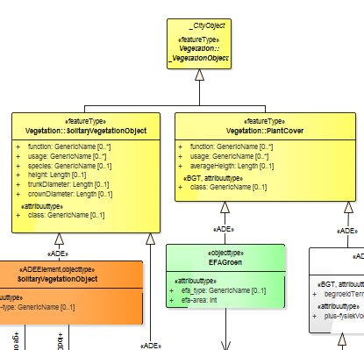
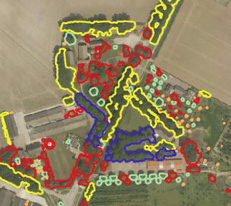
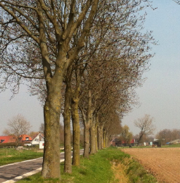
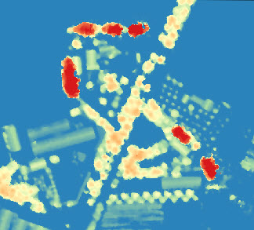
The New CAP Gap
Modelling and delineation of Ecological Focus Areas
MSc Thesis Presentation: Ruud Oberndorff
Supervisors: Drs. Rob van de Velde / Azarakhsh Rafiee - Voermans MSc.
Friday September 4, 2015 @ UNIGIS/VU Amsterdam

Slide 2
Outline
1. Background
2. Research Question
3. Methods
4. Results
5. Conclusions

Slide 3
1. Background
Common Agricultural Policy and greening
Geospatial data: Information models
2. Research Question
3. Methods
4. Results
5. Conclusions
Remote sensing / Object Based Image Analysis

Slide 4
Background: Common Agricultural Policy (CAP)
Changing EU regulation: CAP (January 1, 2015)
Special aim for greening:
Permanent grassland, crop diversification, Ecological Focus Area (EFA)

Slide 5
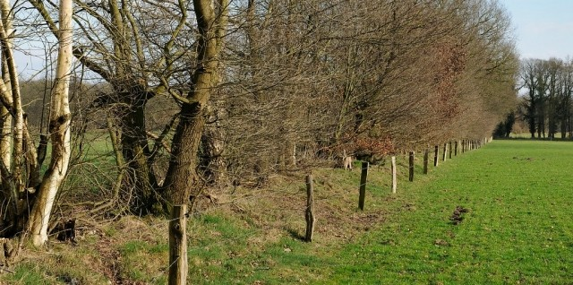
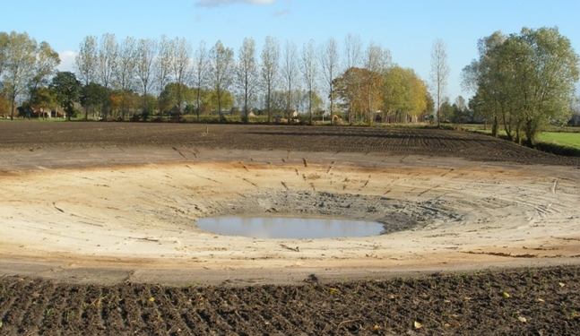
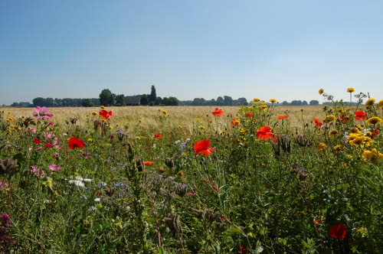
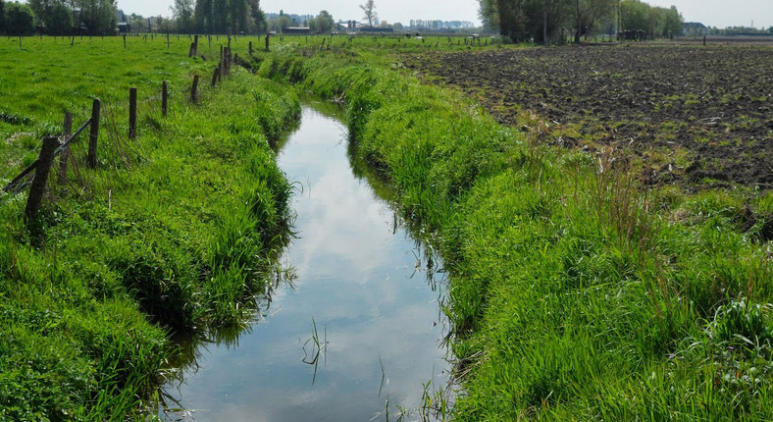
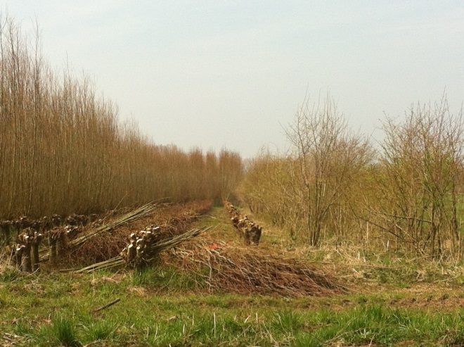
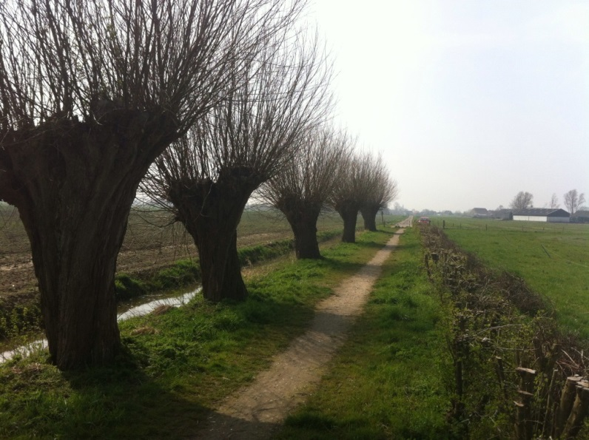
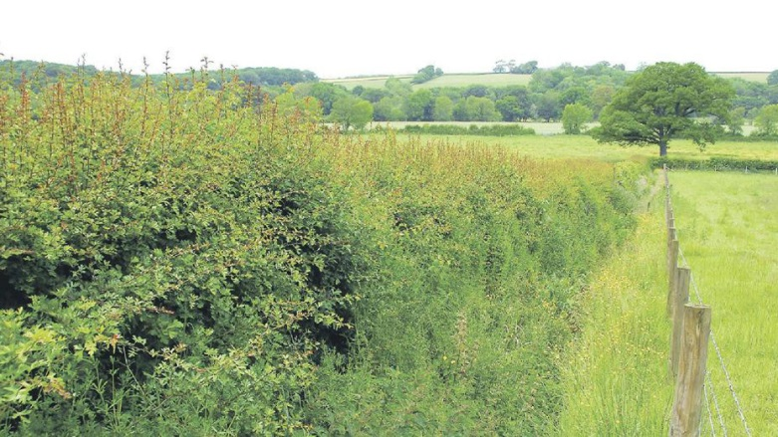
Background: CAP, Ecological Focus Areas
Only Landscape Elements

Slide 6
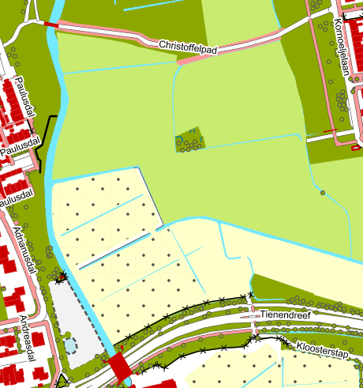
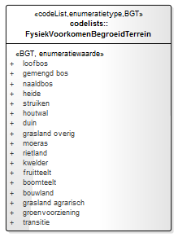
Background: Information Model
IMGeo
Object
BGT: Basisregistratie Grootschalige
Topografie
IMWa
IMNa
IMLB
BGT/IMGeo
BRT/TOP10
Onbegroeid Terreindeel
Begroeid Terreindeel
Water deel
Weg deel
Tunnel deel
Pand
IMGeo
Vlak
IMGeo
Object
Identificatie
Begintijd
Eindtijd
…
Begroeid
Terreindeel
FysiekVoorkomen
Geometrie
…

Slide 7
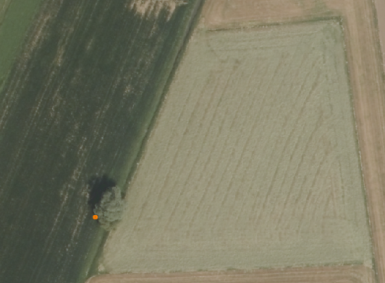
Background: Remote Sensing; Pixel versus Object based
Explore pixels or look for patterns?
R:71
G:75
B:59
NIR:158
Very High resolution → increased variability making classification difficult

Slide 8
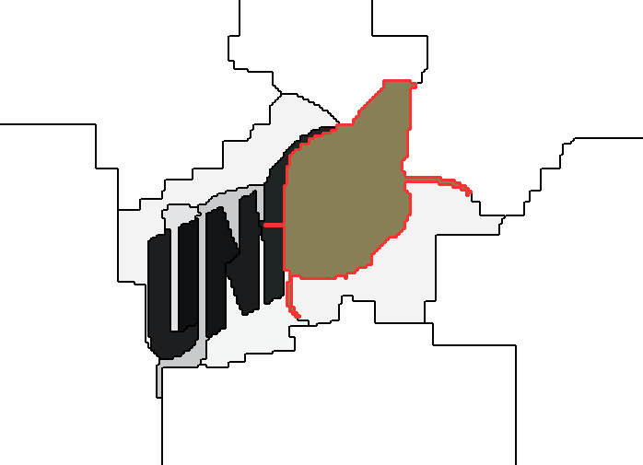
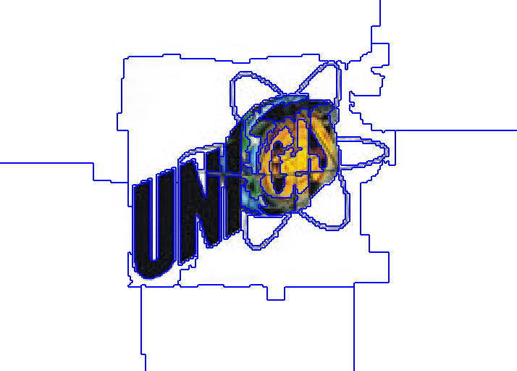
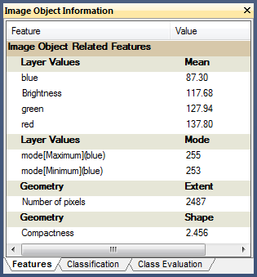
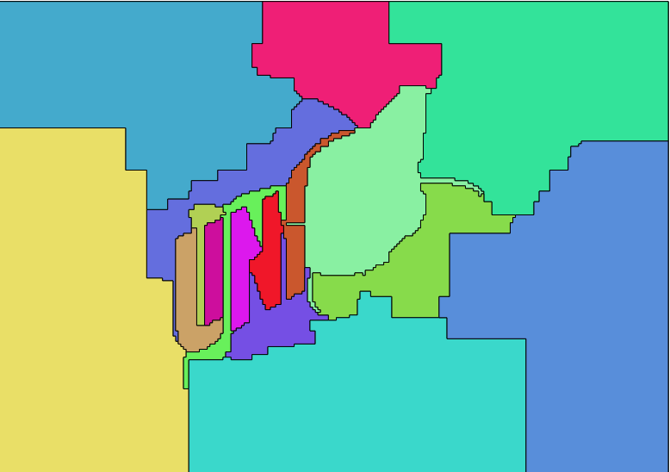
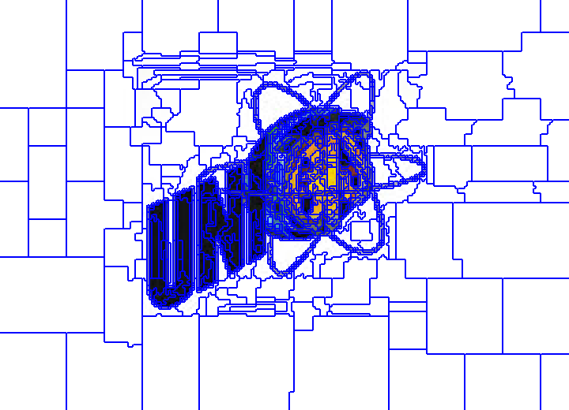
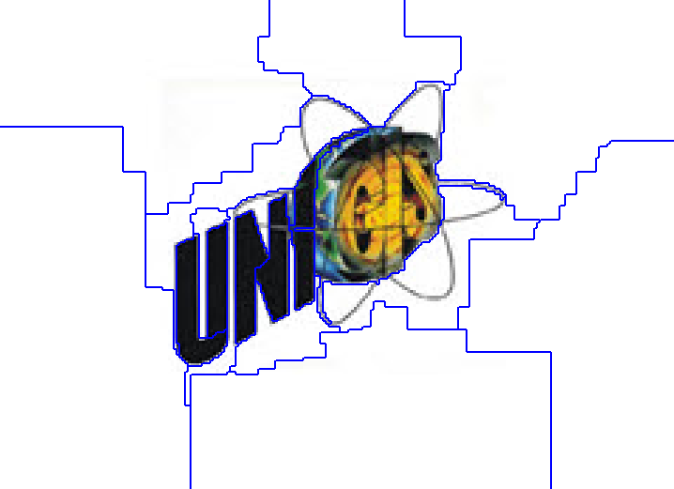
Background: OBIA, Multiresolution Segmentation
Scale (sc)
Shape (s)
Compactness (c)
Color
sc50s9c1
100
sc50s1c1
50
sc50s1c9
5
sc50s9c1

Slide 9
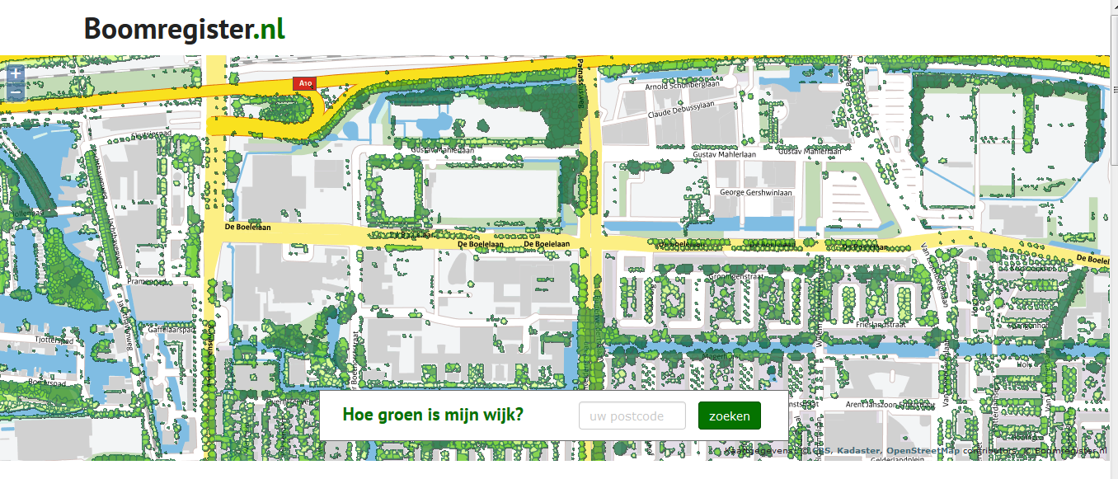
Background: Object Based Image Analysis and Boomregister.nl
Remote Sensing of landscape elements:
OBIA (human visual interpretation, scale, GIS integration)
Ancillary data: Height and NDVI

Slide 10
2. Research Question
1. Background
3. Methods
4. Results
5. Conclusions
Do existing IMs provide the necessary information related to EFAs mentioned in the new CAP?
Is it possible to use RS to delineate green LSE that are not provided through IMs?
IMLB, IMNa, IMWa, BGT/IMGeo, BRT/TOP10
Agreements and differences?
Is pixel-based RS favorable over OBIA?
How to delineate green LSE and measure accuracy?
What segmentation could be used in an OBIA?
Is the delineation of green LSE more accurate using OBIA or the Tree Register?

Slide 11
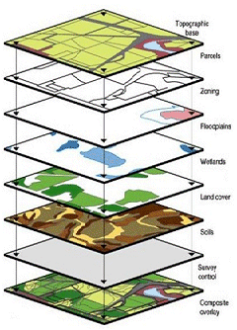
Background: Bringing IM and RS together
“Real world”
Framework for semantics
and ontology
abstracted in
IM Urban area
captured through
Re
Remote Sensing
IM …
semantics for
Re
IM Rural area
OBIA
“Geo-objects”

Slide 12
3. Methods
1. Background
4. Results
5. Conclusions
2. Research Question
Data Specification Cycle
Object Based Image Analysis
Area → Segmentation, Goodness Evaluation, Classification, Accuracy assessment

Slide 13
Method: Data specification cycle
Use-case
Identification of user requirements and spatial object types
As-is analysis
Data specification development
Gap analysis
Collecting missing spatial data

Slide 14
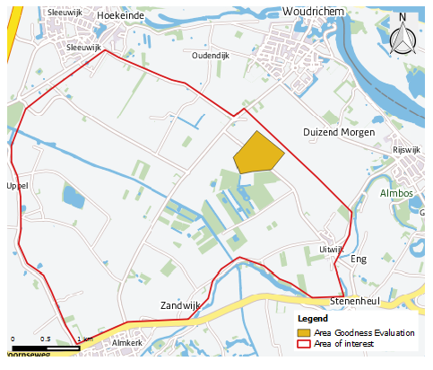
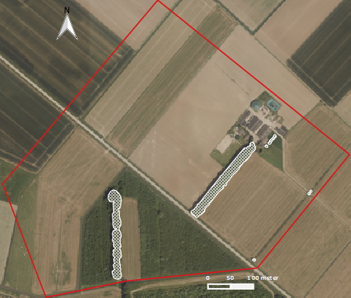
Method: Remote Sensing
Area/Data/software
Segmentation
Evaluation
Classification
Accuracy
30 ha
14 km²

Slide 15
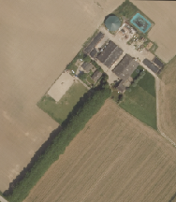
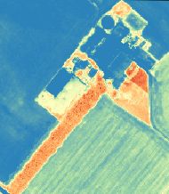
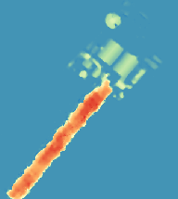
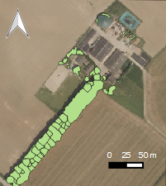
Method: Remote Sensing
Area/Data/software
Segmentation
Evaluation
Classification
Accuracy
True ortho
NDVI
Object height
Tree register (2x)
Acquisition date: 8 June, 2013
Winter 2011
Resolution: 25 cm
75 cm
n.a
Attributes Tree Register:

Slide 16
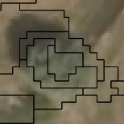
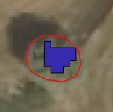
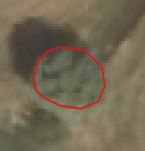
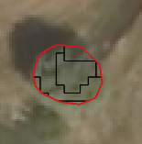
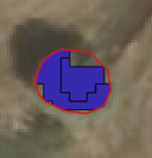
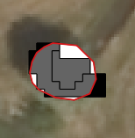
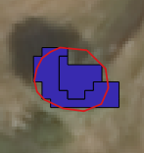
Method: Remote Sensing
Area/Data/software
Segmentation
Evaluation
Classification
Accuracy
Selection of 200 parameters:
4 scale x 5 shape x 5 compactness
Based on 2 datasets: Height / Height and NDVI
Selection 100%
Intersect
Selection 60%
(Marpu et al., 2010)
Missing or extra pixels
Spatial join
Evaluation of intermediate result

Slide 17
Method: Remote Sensing
Area/Data/software
Segmentation
Evaluation
Classification
Accuracy
- From potential tree → Trees and Tree line
OBIA
Tree Register
Corrected Tree Register
> 2 meter Height
> 2 meter Height
> 2 meter Height
Classification (NDVI)
Potentail Tree
Tree group mask
Trees outside TOP10
Calculate metrics
Classification
Road mask
Tree
Tree Line
Tree Other
- Classification in QGIS using simple SQL instructions

Slide 18
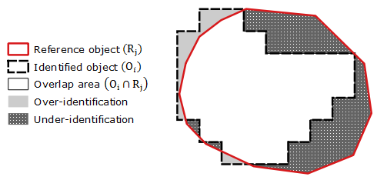
Method: Remote Sensing
Area/Data/software
Segmentation
Evaluation
Classification
Accuracy
OBIA is not complete unless the geometric accuracy is determined
(Albrecht, 2008)
(Ardilla et al., 2012)
Geometric accuracy:
OverID : 1-(Overlap area/Identified Object) [0,1]
UnderID : 1-(Overlap area/Reference Object) [0,1]
Total error : √ (OverID²+UnderID²/2) [0,1]
Thematic accuracy indicators:
True positive | False positive | False negative
Correctly identified | Identified, not existing | Missed tree

Slide 19
4. Results
1. Background
5. Conclusions
2. Research Question
3. Methods
IM → Use-case, process: “Create EFA - layer”
RS → Delineation of trees and tree lines
IM → Identification of objects

Slide 20
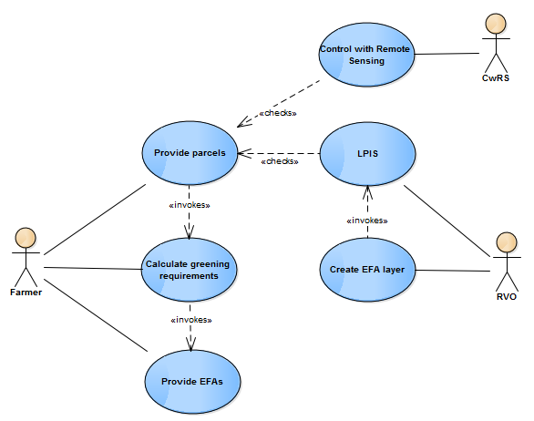
Results IM: Data Specification Cycle
Use-case
As-is / Gap-analysis
Data specification
Requirements
Use Case:
“Monitoring EFA requirements for farmers”

Slide 21
Results IM: Data Specification Cycle
Use-case
As-is / Gap-analysis
Data specification
Requirements
Element | Dimensions | Geometry | Object
Tree |  | point | EFaTree
Tree line |  | polygon | EfaGreen
Tree group/ Coppice |  | polygon | EfaGreen
Hedge/ wooded bank |  | polygon | EfaGreen
Watercourse/ vegetation |  | Line/ polygon | EfaWater/ EfaGreen
Pond |  | polygon | EfaPond
SNL | Collection of above landscape elements |  | IMNa
Also used:
Scale
Temporal profile
Accuracy
Identification
Reference system
Data quality
4
4 m
4
5 m
4
0.3 ha
10 m
Not used:
Topology
Coverages
Object referencing
Portrayal
1-6 m
0.1 ha

Slide 22
Results IM: Data Specification Cycle
Use-case
As-is / Gap-analysis
Data specification
Requirements
Object | BGT/IMGeo |  |  |  | IMWa |  |  |  | IMNa
 | Th | Te | A | G | Th | Te | A | G | Th | Te | A | G
EfaPond
EfaWater
EfaGreen
EfaTree
EfaSNL
n.a.
Th=Thematic, Te=Temporal, A=Accuracy, G=Geometry
Focus RS → Single Tree and Tree line

Slide 23
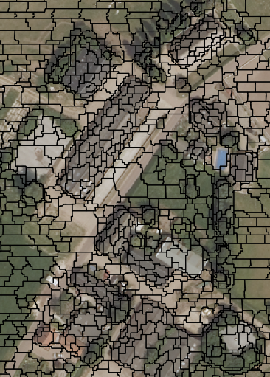
Results RS: Tree Delineation
Segmentation
Evaluation
Classification
Accuracy
Start | 200 parameters
Intermediate | 117 parameters -/-
Remaining | 83 parameters
Dismissed are mainly large scale and combination NDVI and height
Single trees are more critical then tree lines
Selection of evaluation objects
Segmentation based on height:
- Scale: 10
- Shape: 0.5
- Compactness: 0.1
Computation time: 6 - 9 hours

Slide 24
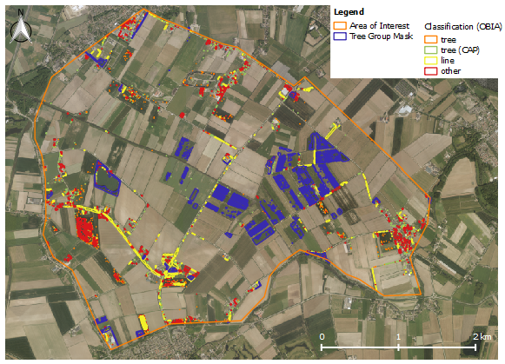
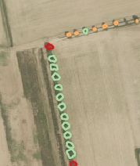
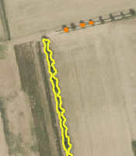
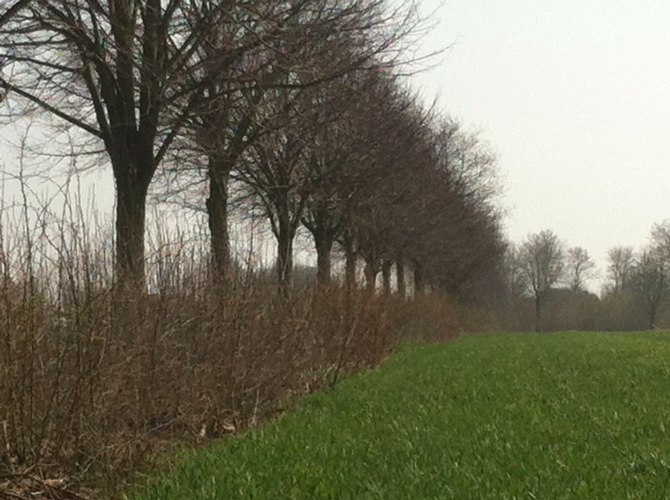
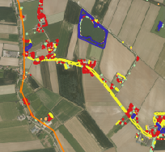
Results RS: Tree Delineation
Segmentation
Evaluation
Classification
Accuracy
Tree register
OBIA
Tree line and understory
Tree Register

Slide 25
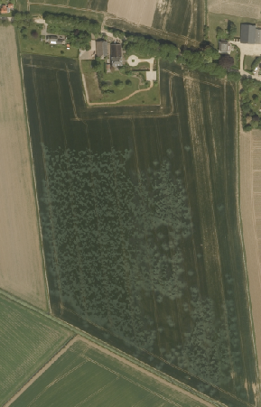
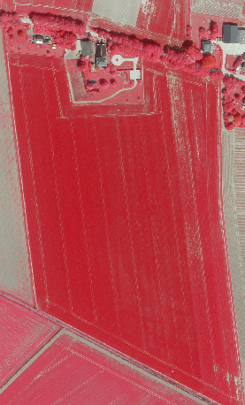
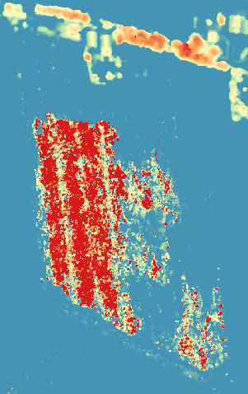
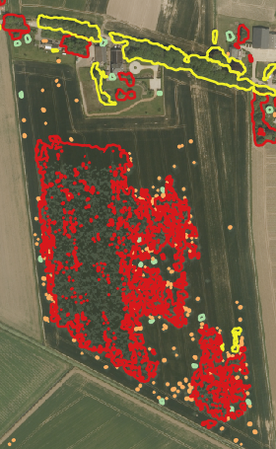
Results RS: Tree Delineation
Segmentation
Evaluation
Classification
Accuracy
True ortho
CIR
Object height
OBIA

Slide 26
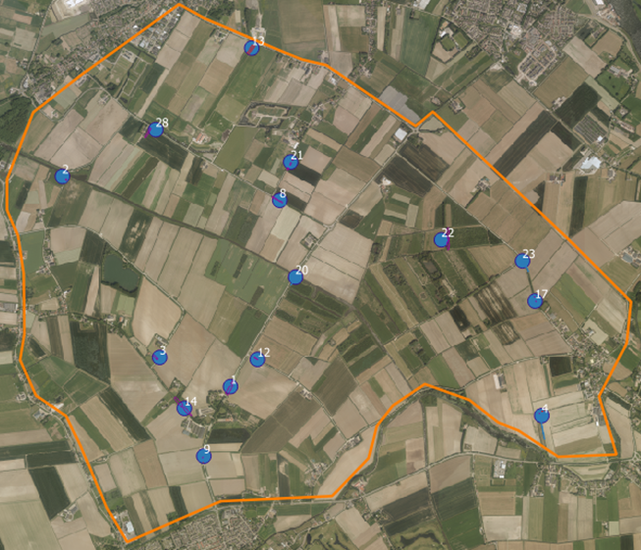
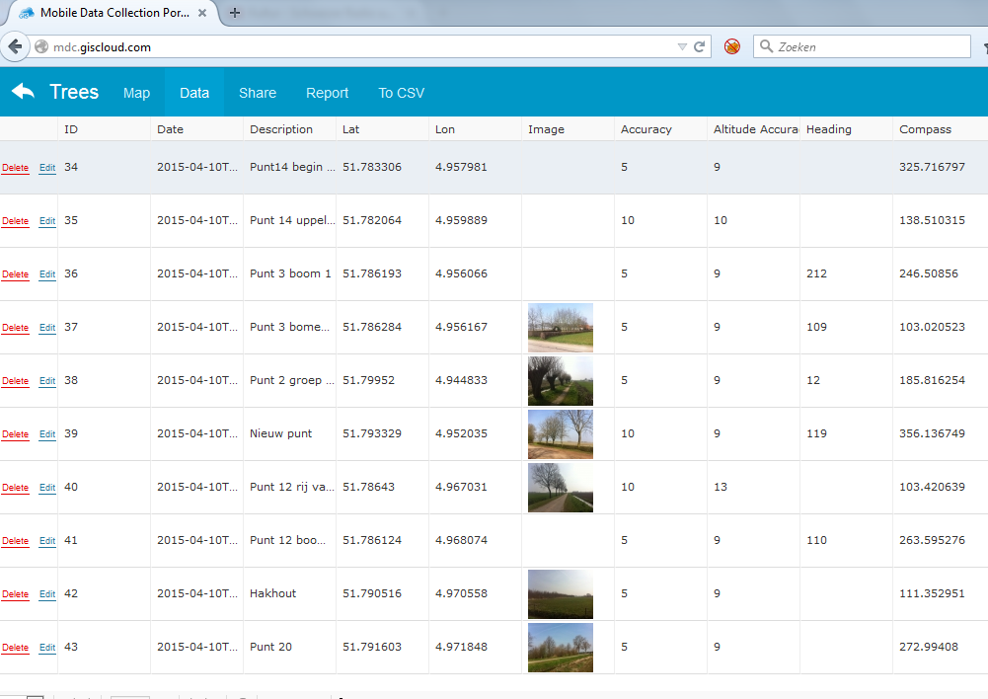
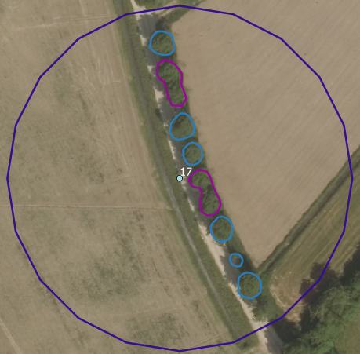
Results RS: Tree Delineation
Segmentation
Evaluation
Classification
Accuracy

Slide 27
Results RS: Tree Delineation
Segmentation
Evaluation
Classification
Accuracy
Thematic Accuracy
Identified, not existing
Missed tree
Object accuracy:
Selection of objects is critical
Difficult to asses: validation objects ≠ delineated objects
Not always a one-to-one relation
Corrected Tree Register best fit

Slide 28
5. Conclusions
1. Background
2. Research Question
3. Methods
4. Results

Slide 29
1. Do existing IMs provide relevant information related to EFAs?
Data Specification Cycle
EU Fuzzy Definition
Fuzziness about exact definition
(e.g. tree line as polygon, but what border)
What is a tree?
(e.g. what is it’s height?)
Definition of objects
Fitness for Use
IM Fuzzy Definition
Fuzziness about exact definition
(e.g, what is the delineation of an object?)
How is an IM used?
(e.g. user view and underlying use-case)
Existing data sets (IMs)
Domain and regulation specialists
GIS experts
Body of Knowledge

Slide 30
Is it possible to use RS to delineate green landscape elements not provided in IMs?
Object definition
distinct: line, point, polygon
Exact delineation?
Information Model
Technical constraints:
OBIA:
Segmentation and evaluation
Classification
Accuracy assessment
Visual inspection necessary
Corrected Tree Register best choice
Data sources
Remote Sensing
Object definition
Continuous

